Slide 1
0001000001010101010101010101001010001011100101110101010100010101010101001010100101010101001010100101010010101010101010
--------------------------------------------------------------------
December, 26, 2014………………… Graduate Thesis Protection ………………………………………………………………………………………………………………………….
|||||||||||||||||||||||||||||||||||||||||||||||||||||||||||||||||||||||||||||||||||||||||||||||||||||||||||||
The commercial
center's restaurant management
Supervisor:
Trần Đình Trí
Team member:
Nguyễn Tuấn Vương
Nguyễn Văn Hoàng
Nguyễn Xuân Tùng
Phạm Sỹ Vinh
Phạm Ngọc Thanh
01010100010101010101001010100101010101001010100101010010101010101010

Slide 2
Introduction
Software Project Management Plan
System Requirements Specifications
System Design Description
Project Result
Lesson learned
Demo
Question & Answer
Table of Content
System Implementation & Testing

Slide 3


Introduction
Project Result
Introduction
Project Plan
System
Lessons Learned
Requirements Specifications
Design Description
Implementation & Testing
Project idea
Scope

Slide 4

Introduction
Project Result
Introduction
Project Plan
System
Lessons Learned
Requirements Specifications
Design Description
Implementation & Testing
Project idea
Background:
✔ E-commerce & commercial very development
=> management demand
Scope

Slide 5
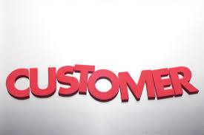


Introduction
Project Result
Introduction
Project Plan
System
Lessons Learned
Requirements Specifications
Design Description
Implementation & Testing
Project idea
Idea:
✔ Book order before come a restaurant
✔ Rent a stalls
✔ Manage stalls easier
=> All is our website!
Scope

Slide 6
Introduction
Project Result
Introduction
Project Plan
System
Lessons Learned
Requirements Specifications
Design Description
Implementation & Testing
Our customer & content
Project idea
Director:
Manage all ground in restaurants system
Our system handle two main contents :
Manage all restaurant ground in commercial center
Manage each restaurant.
Scope

Slide 7
Introduction
Project Result
Introduction
Project Plan
System
Lessons Learned
Requirements Specifications
Design Description
Implementation & Testing
In Scope
Out Scope
Project idea
• Our system use Vietnamese language
• Our system handle problems turn around two main contents
• Our system do not use for delivery online and payment via credit card on the websites.
• Our system do not do statistics
• Our system do not manage time work, salary of staff
Scope

Slide 8
Introduction
Project Plan
Project Result
Project Plan
System
Lessons Learned
Requirements Specifications
Design Description
Implementation & Testing
Proposed
System
Development
Enviroment
Project
Organization

Slide 9
Introduction
Project Plan
Project Result
Project Plan
System
Lessons Learned
Requirements Specifications
Design Description
Implementation & Testing
Proposed
System
The Our System Will Provide The Main Features Below:
Stalls Management
Contracts Management
Restaurants Management
Foods Management
Orders Management
Staff Management
Development
Enviroment
Project
Organization

Slide 10
Introduction
Project Plan
Project Result
Project Plan
System
Lessons Learned
Requirements Specifications
Design Description
Implementation & Testing
Hardware Requirement
Proposed
System
A computer with 4GB, core i3, 500GB of hard disk or larger
Software Requirement
Operating System: Microsoft® Window 7
Netbean 7.2, Notepad ++
Database Tools: MySQL Workbench 6.2 CE
Photoshop CC
Source manage: Tortoise SVN.
Browser: Chrome 31, Firefox 20, IE 10 or higher
Language: Java, Html 5, Javascipt, Css3 , Jquery
Document Tools : : Microsoft® Office 2010
Development
Enviroment
Project
Organization

Slide 11
Introduction
Project Plan
Project Result
Project Plan
System
Lessons Learned
Requirements Specifications
Design Description
Implementation & Testing
System
Process
Model
Proposed
System
Requirements
Analysis & Design
Implementation
Task
Sheet
Planning
Deployment
Development
Enviroment
Initial Planning
Testing
Roles &
Responsibility
Evaluation
Project
Organization
Tools &
Techniques

Slide 12
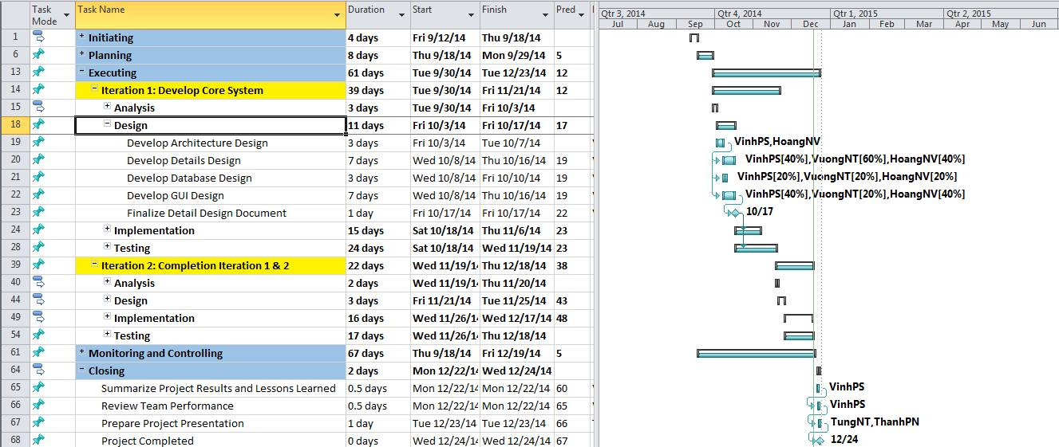
Introduction
Project Plan
Project Result
Project Plan
System
Lessons Learned
Requirements Specifications
Design Description
Implementation & Testing
System
Process
Model
Proposed
System
Requirements
Analysis & Design
Implementation
Task
Sheet
Planning
Deployment
Development
Enviroment
Initial Planning
Testing
Roles &
Responsibility
Evaluation
Project
Organization
Tools &
Techniques

Slide 13
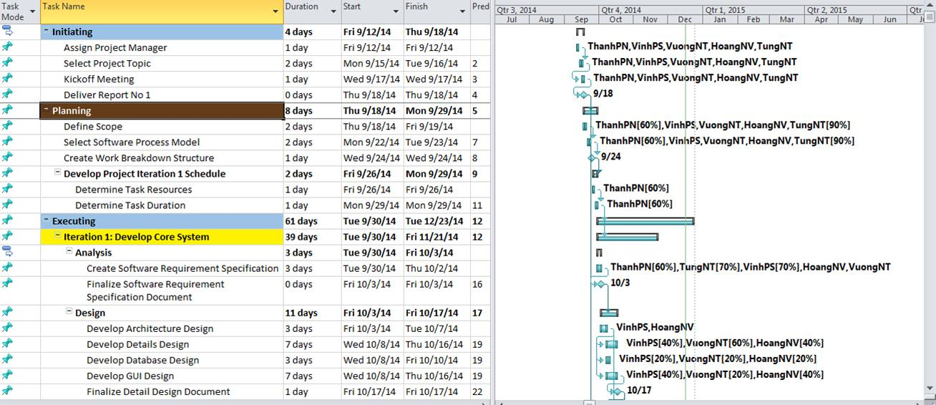
Introduction
Project Plan
Project Result
Project Plan
System
Lessons Learned
Requirements Specifications
Design Description
Implementation & Testing
System
Process
Model
Superviser
Trần Đình Trí
Documenter
Analyst
Project Manager
Nguyễn Tuấn Vương
Designer
Developer
Tester
Quality Assurance
Nguyễn Tuấn Vươg
Nguyễn Văn Hoàng
Nguyễn Tuấn Vương
Phạm Sỹ Vinh
Nguyễn Văn Hoàng
Nguyễn Xuân Tùng
Phạm Ngọc Thanh
Phạm Sỹ Vinh
Nguyễn Tuấn Vương
Nguyễn Văn Hoàng
Phạm Sỹ Vinh
Nguyễn Tuấn Vương
Nguyễn Văn Hoàng
Phạm Ngọc Thanh
Nguyễn Xuân Tùng
Nguyễn Tuấn Vương
Phạm Ngọc Thanh
Nguyễn Xuân Tùng
Phạm Ngọc Thanh
Proposed
System
Task
Sheet
Development
Enviroment
Roles &
Responsibility
Project
Organization
Tools &
Techniques

Slide 14
Introduction
Project Plan
Project Result
Project Plan
System
Lessons Learned
Requirements Specifications
Design Description
Implementation & Testing
System
Process
Model
Tools:
  Microsoft® Office 20010, Microsoft® Project 2010, Microsoft® Visio 2010
  Photoshop CC
  IDE: Netbean 7.2.1, Notepad++ v6.8.8
  Database: MySQL Workbench 6.2 CE
  Manage source: Tortoise SVN 1.8.7
  Browser: Chrome 34.0.1847.131 m, Firefox 23.0.1, Internet Explorer 10
Techniques:
  Platform: Java
  Database: MySQL Workbench 6.2 CE
  Client: HTML5, CSS3 (Bootstrap 3), JavaScript (jQuery, jPlayer), AJAX
Proposed
System
Task
Sheet
Development
Enviroment
Roles &
Responsibility
Project
Organization
Tools &
Techniques

Slide 15
Introduction
Project Plan
System
Project Result
Lessons Learned
Requirements Specifications
Design Description
Implementation & Testing
User
Requirement
Specification
Functional
Requirements
Entity
Relationship
Diagram

Slide 16
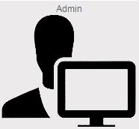

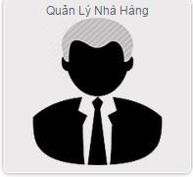

Introduction
Project Plan
System
Project Result
Lessons Learned
Requirements Specifications
Design Description
Implementation & Testing
User
Requirement
Specification
Six User Groups In Our System:
User in Back-end system
Guest:
Member
Restaurant Staff
Restaurant Manager
Director
Administrator
Admin
Giám đốc
Functional
Requirements
Quản lý nhà hàng
Nhân viên nhà hàng
Entity
Relationship
Diagram

Slide 17
Introduction
Project Plan
System
Project Result
Lessons Learned
Requirements Specifications
Design Description
Implementation & Testing
User
Requirement
Specification
Functional
Requirements
Entity
Relationship
Diagram
Example:
Restaurant manager Diagram

Slide 18
Introduction
Project Plan
System
Project Result
Lessons Learned
Requirements Specifications
Design Description
Implementation & Testing
  ✔ Register to rent a new stall
  ✔ View list their contracts
  ✔ Manage their restaurants
    Manage information of restaurant
    Manage Table
    Manage Food
  ✔ Manage order from customer
  ✔ Manage Staff account
  ✔ Search information about Food, Oder, Guest,...
User
Requirement
Specification
Functional
Requirements
Entity
Relationship
Diagram

Slide 19
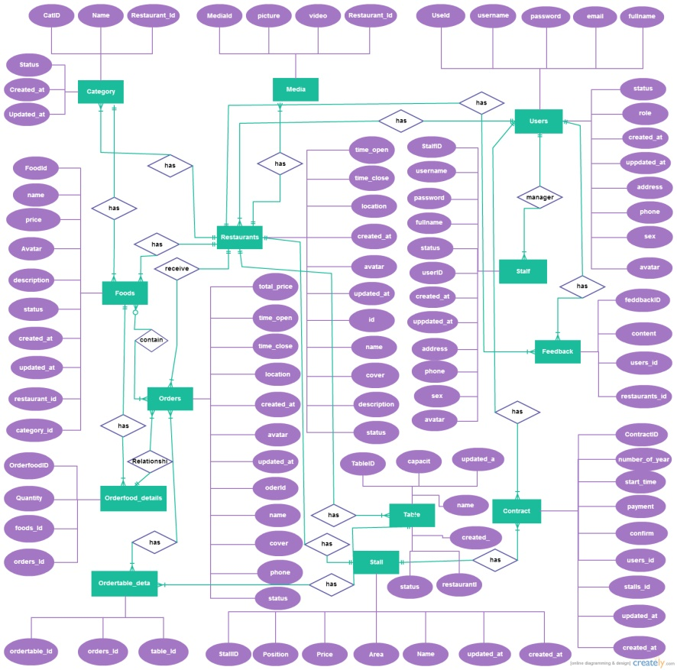
Introduction
Project Plan
System
Project Result
Lessons Learned
Requirements Specifications
Design Description
Requirements Specifications
Design Description
Implementation & Testing
User
Requirement
Specification
Functional
Requirements
Entity
Relationship
Diagram

Slide 20
Introduction
Project Plan
System
Project Result
Lessons Learned
Requirements Specifications
Design Description
Implementation & Testing
System
Architectural
Design
Component
Diagram
Detailed
Description
Database
Design

Slide 21
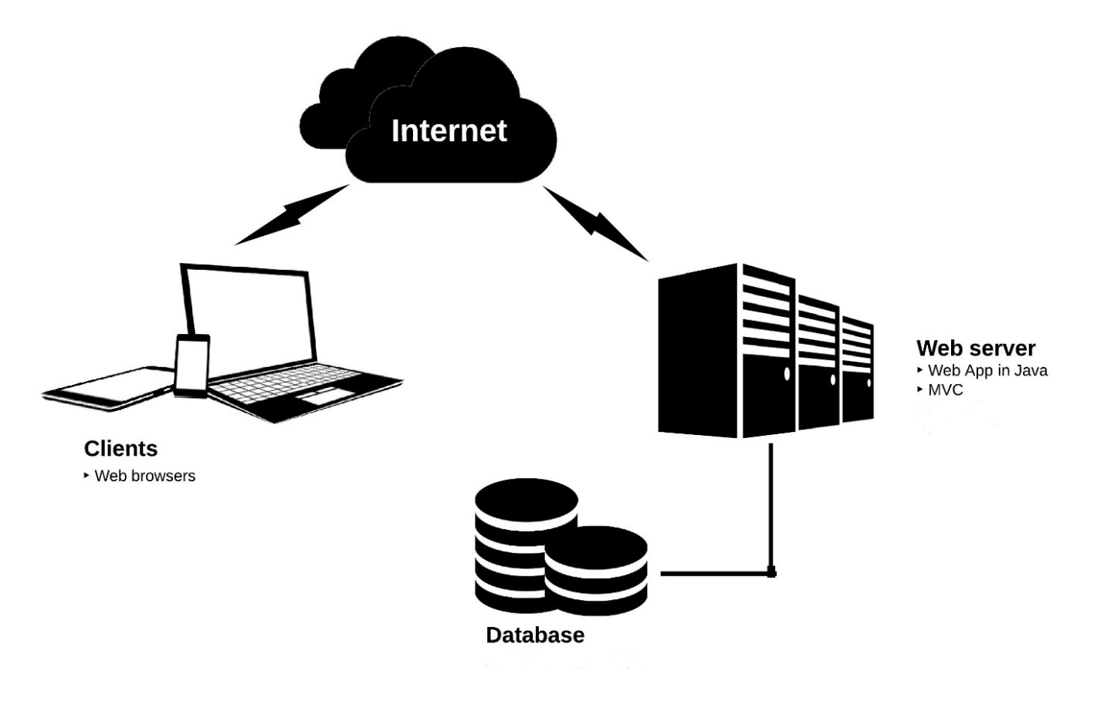
Introduction
Project Plan
System
Project Result
Lessons Learned
Requirements Specifications
Design Description
Implementation & Testing
System
Architectural
Design
Component
Diagram
Detailed
Description
Database
Design

Slide 22
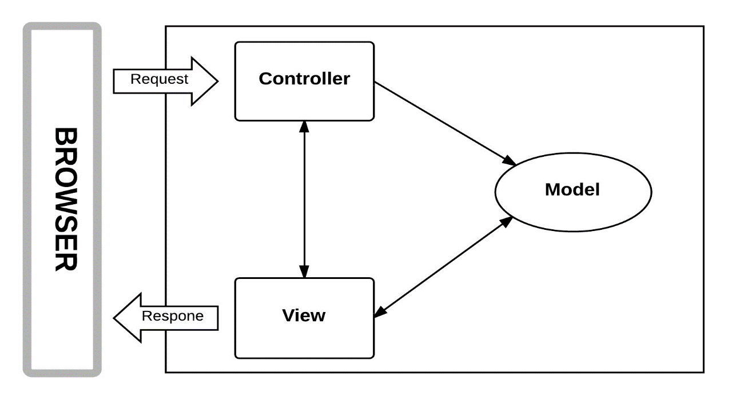
MVC Model
Introduction
Project Plan
System
Project Result
Lessons Learned
Requirements Specifications
Design Description
Implementation & Testing
System
Architectural
Design
Component
Diagram
Detailed
Description
Database
Design

Slide 23
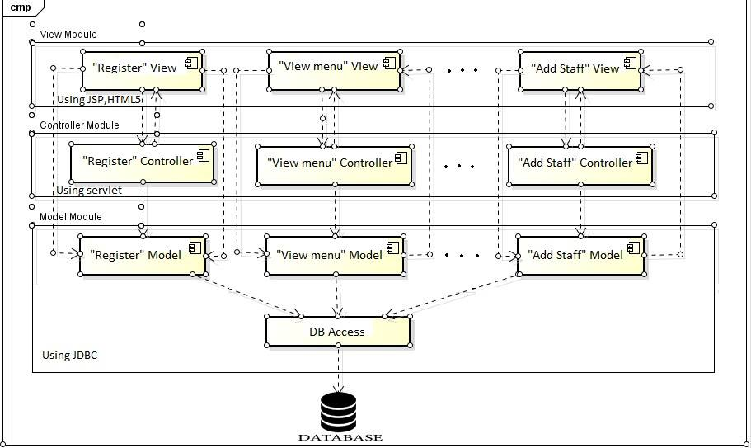
Introduction
Project Plan
System
Project Result
Lessons Learned
Requirements Specifications
Design Description
Implementation & Testing
System
Architectural
Design
Component
Diagram
Detailed
Description
Database
Design

Slide 24
Introduction
Project Plan
System
Project Result
Lessons Learned
Requirements Specifications
Design Description
Implementation & Testing
System
Architectural
Design
Component
Diagram
Detailed
Description
Database
Design
Class Diagram

Slide 25
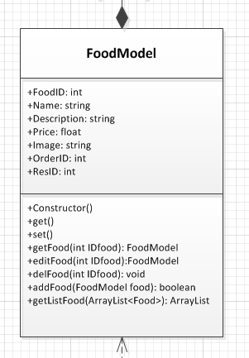
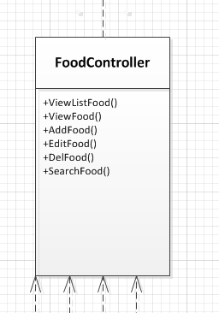
Introduction
Project Plan
System
Project Result
Lessons Learned
Requirements Specifications
Design Description
Implementation & Testing
System
Architectural
Design
Component
Diagram
Detailed
Description
Database
Design
Example : Class FoodController in class diagram

Slide 26
Introduction
Project Plan
System
Project Result
Lessons Learned
Requirements Specifications
Design Description
Implementation & Testing
System
Architectural
Design
Component
Diagram
Detailed
Description
Flow-chart for account management of admin
Database
Design

Slide 27
Introduction
Project Plan
System
Project Result
Lessons Learned
Requirements Specifications
Design Description
Implementation & Testing
System
Architectural
Design
Component
Diagram
Detailed
Description
Database
Design
Sequence Diagram for Funtionality AddFood

Slide 28
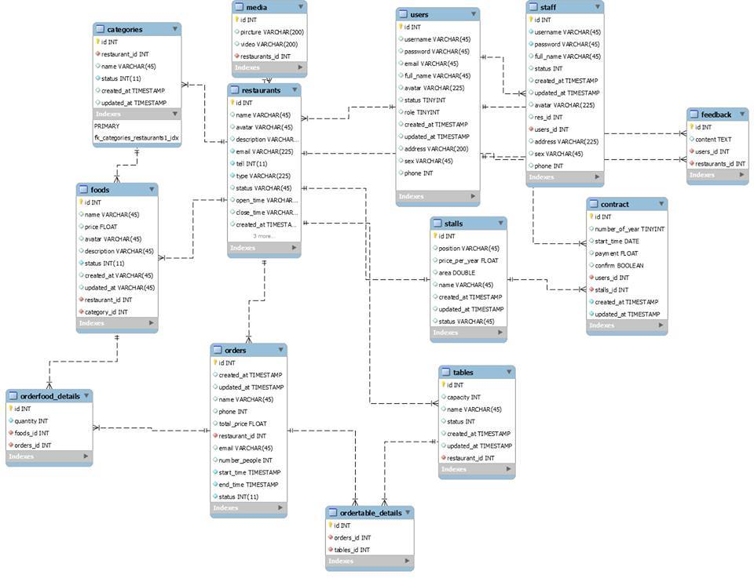
Introduction
Project Plan
System
Project Result
Lessons Learned
Requirements Specifications
Design Description
Implementation & Testing
Design Description
Implementation & Testing
System
Architectural
Design
Component
Diagram
Detailed
Description
Database
Design

Slide 29
Introduction
Project Plan
System
Project Result
Lessons Learned
Requirements Specifications
Design Description
Implementation & Testing
Testing
Strategy
Testing
Process
Testing
Enviroment
Test Plan
Test Case
Test Result

Slide 30
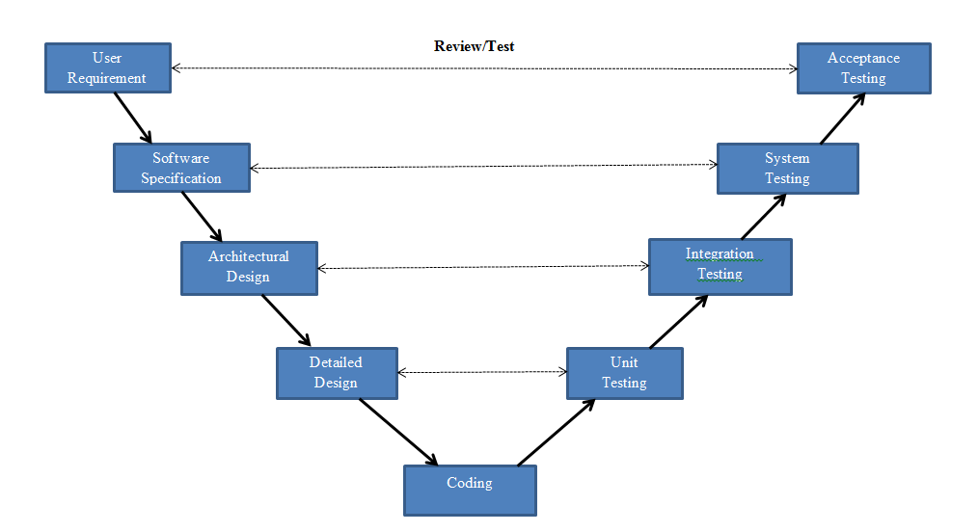
Introduction
Project Plan
System
Project Result
Lessons Learned
Requirements Specifications
Design Description
Implementation & Testing
Testing
Strategy
Testing
Process
Testing
Enviroment
Test Plan
Test Case
Test Result

Slide 31
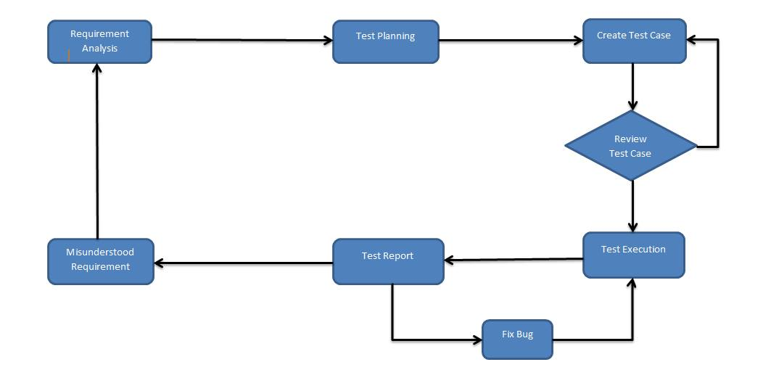
Introduction
Project Plan
System
Project Result
Lessons Learned
Requirements Specifications
Design Description
Implementation & Testing
Testing
Strategy
Testing
Process
Testing
Enviroment
Test Plan
Test Case
Test Result

Slide 32


Introduction
Project Plan
System
Project Result
Lessons Learned
Requirements Specifications
Design Description
Implementation & Testing
Testing
Strategy
Testing
Process
Google Chrome Version 36.0.1985.143 m
Testing
Enviroment
Test Plan
RAM 4.0 GB | CPU i5 2.40GHz
Test Case
Test Result

Slide 33
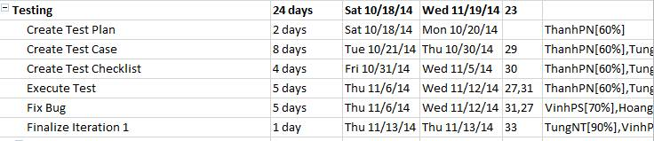
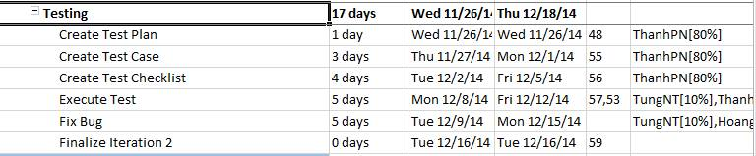
Introduction
Project Plan
System
Project Result
Lessons Learned
Requirements Specifications
Design Description
Implementation & Testing
Testing
Strategy
ITERACTIVE 1:
Testing
Process
Testing
Enviroment
Test Plan
ITERACTIVE 2:
Test Case
Test Result

Slide 34
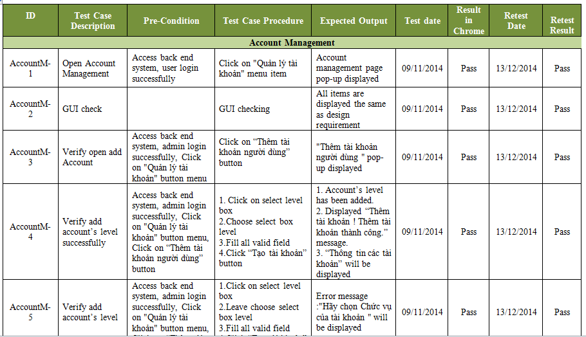
Introduction
Project Plan
System
Project Result
Lessons Learned
Requirements Specifications
Design Description
Implementation & Testing
Testing
Strategy
Testing
Process
Testing
Enviroment
Test Plan
Test Case
Test Result
EXAMPLE TESTCASE

Slide 35
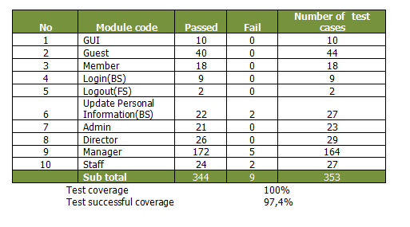
Introduction
Project Plan
System
Project Result
Lessons Learned
Requirements Specifications
Design Description
Implementation & Testing
Testing
Strategy
Testing
Process
Testing
Enviroment
Test Plan
Test Case
Test Result

Slide 36
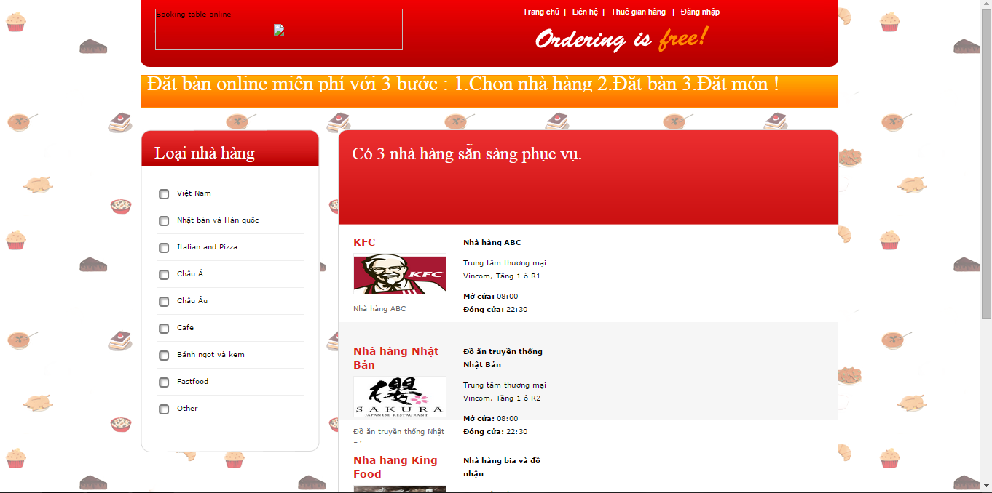
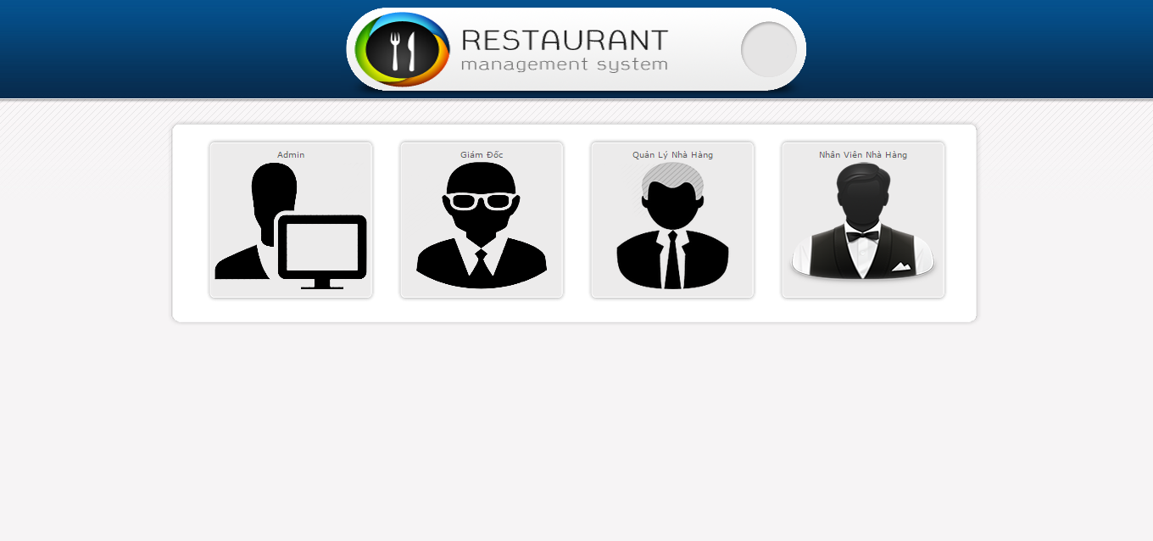
Project Result
Introduction
Project Plan
Project
Result
Lessons Learned
System
Lessons
Learned
Requirements Specifications
Design Description
Implementation & Testing

Slide 37
Introduction
Project Plan
System
Project Result
Lessons Learned
Requirements Specifications
Design Description
Implementation & Testing
Working in Group
Management skills
Communication
Resolve Conflicts
Organize
Planning

Slide 38
Introduction
Project Plan
System
Project Result
Lessons Learned
Requirements Specifications
Design Description
Implementation & Testing
DEMO
Q&A

Slide 39
Introduction
Project Plan
System
Project Result
Lessons Learned
Requirements Specifications
Design Description
Implementation & Testing
DEMO
Q&A

Slide 40
THANKS …………………………………………………………………………………….……………………….
WATCHING ================================
FOR------------------------------------------------

