Slide 1

Capstone Project
FPT University Online Student Services
Supervisor: | Mr. Phan Trường Lâm
FUOSS Group Members: | Phạm Trung Hiếu | SE02682
 | Lưu Chính Nghĩa | SE02677
 | Hoàng Tuấn Anh | SE02897
 | Vũ Đức Nhân | SE02928
 | Trần Anh Tuấn | SE02727

Slide 2
Presentation Content
Introduction
HieuPT
Software Project Manager Plan
Software Requirement Specification
Software Design Description
Software Test Document
NghiaLC
HieuPT
AnhHT & NhanVD
Demo
TuanTA

Slide 3
Introduction
Project name:
FPT University Online Student Services
Project code: FUOSS
Project group name: FUOSS Group
Project type: Web Application
Timeline: 5th May 2015 – 23rd August 2015

Slide 4
Problem
Introduction
Student Services Department (SSD) overload to receive request from student at starting new semester
Two types of receiving request:
  Direct: SSD
  Online: www.uniap.fpt.edu.vn

Slide 5
Introduction
Idea
Build a web application allow:
User login by Google email account (@fpt.edu.vn)
Student submits request online
Solving steps of request is automatic
Staff handles request online

Slide 6
Software Project Management Plan
Organization Structure
Software Process Model
Technologies & Development Tools
Work Breakdown Structure (WBS)
Team Communication
Risk Management

Slide 7
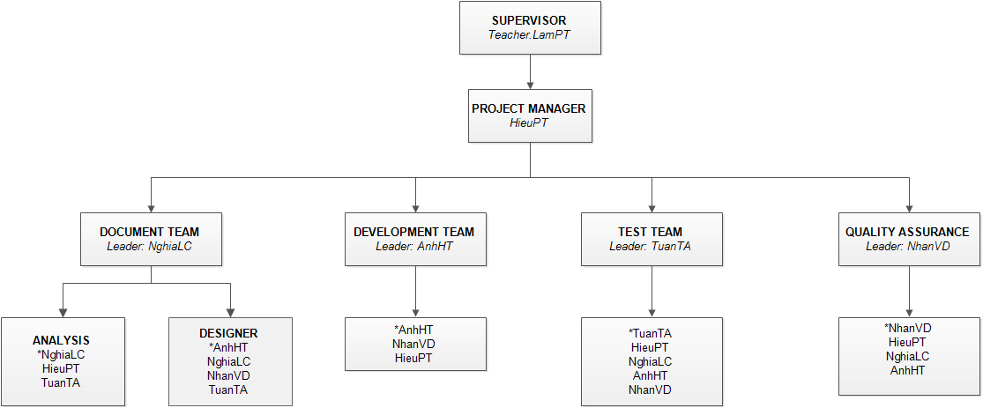
Software Project Management Plan
Organization Structure

Slide 8
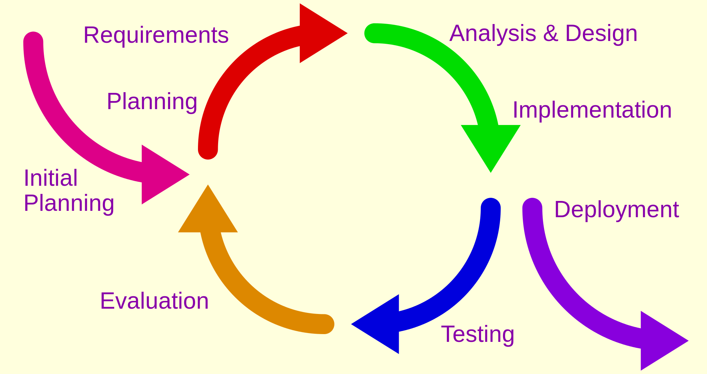
Software Project Management Plan
Software Process Model
Iterative and Incremental Model

Slide 9






Software Project Management Plan
Technologies

Slide 10


Software Project Management Plan
Development Tools
Hardware:
  Develop: Personal computers (Windows 7, Windows 8)
  Deploy: Local server
  Test: Personal computers
Software:
  Development kit: php 5.6.8
  Design: Edraw Max 7.2, Microsoft Visio 2010,
  Dreamwaever CS6
  Running & test: Firefox 40.0.2, Chrome 44, IE 9
  Other: Microsoft Word 2010, Microsoft Excel 2010
  Microsoft Project 2010, Microsoft Powerpoint 2010

Slide 11
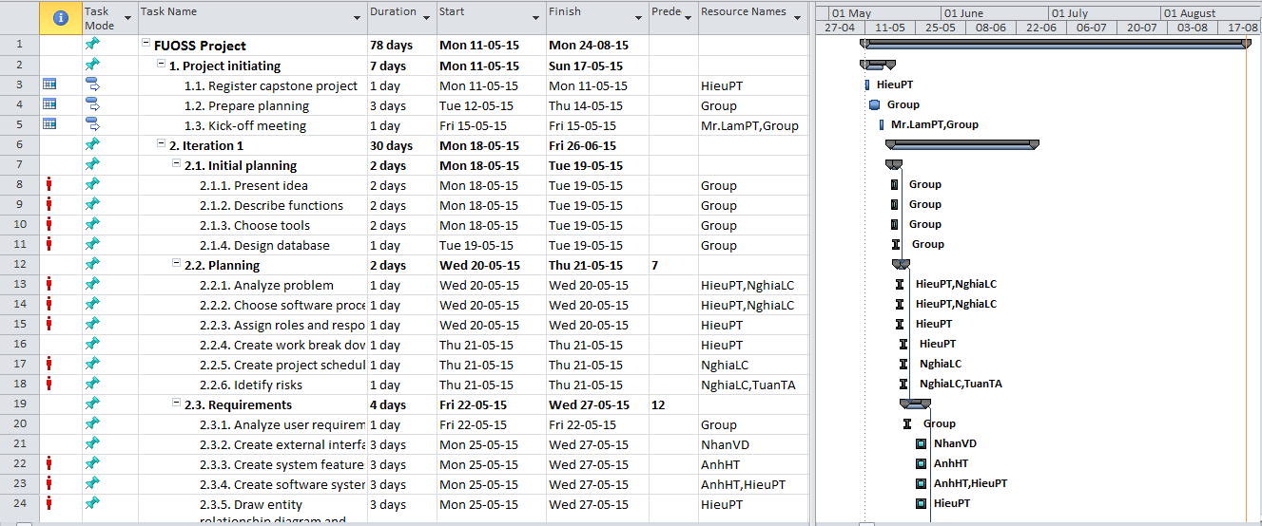
Software Project Management Plan
WBS

Slide 12
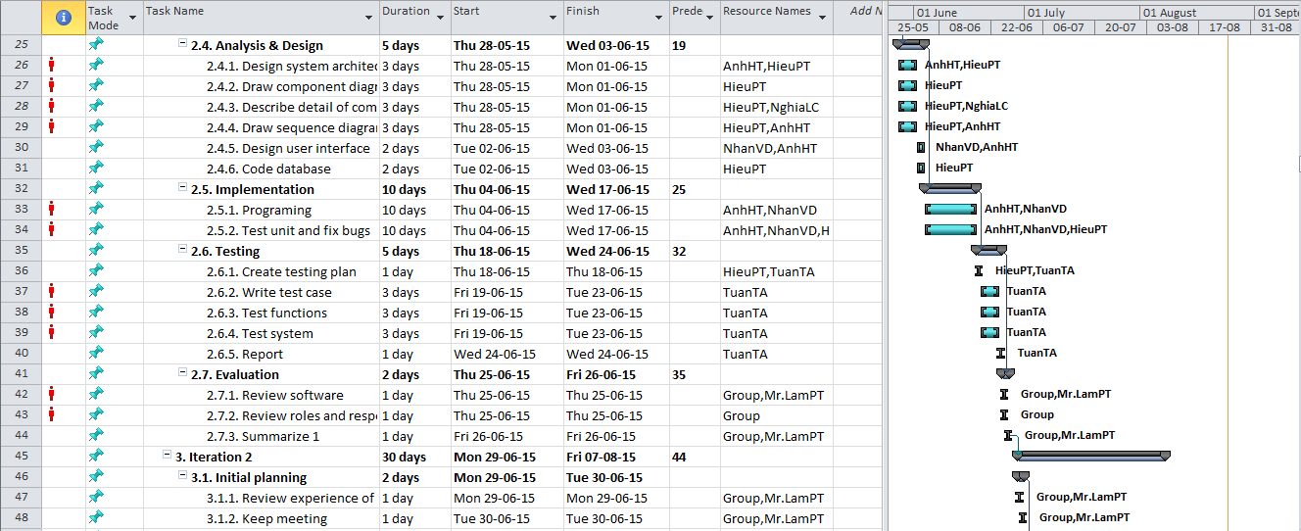
Software Project Management Plan
WBS (continue)

Slide 13
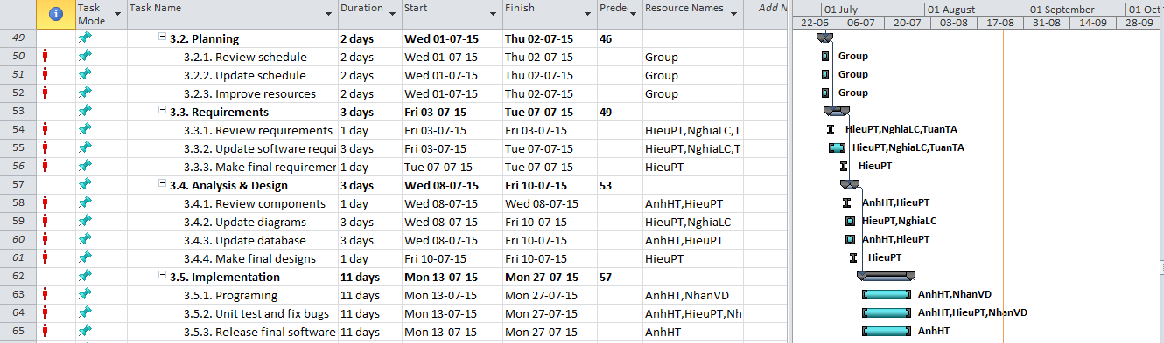
Software Project Management Plan
WBS (continue)

Slide 14
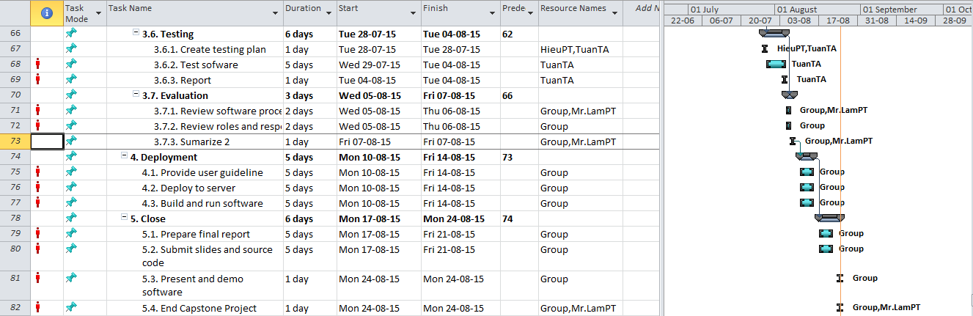
Software Project Management Plan
WBS (continue)

Slide 15




Software Project Management Plan
Team Communication
Meeting supervisor: Once a week
Group working time: 5 days/week
Location: Class room, Dormitory
Communication:

Slide 16
Software Project Management Plan
Project Risk Management
No | Name | Probability | Prevention | Correction | Impact
R1 | Team member absence | Medium | The team member must notice to the project manager about their absence at least 1 day before. | Other member will cover plan of absence member | High
R2 | Miscommunication | Medium | - Participate fully in the meetings - Take note all content that meeting mention | When miscommunication is detected, we will hold a meeting between all of our members and even customer if necessary to clear things up. | High
R3 | Time shortage | High | - PM planning to divide of work logical - Perform work on schedule | - Accelerate some phases if possible - Members support each other | Very high
R4 | Lost data | Low | Save all the sources, documents and components in a hard drive, external HDD and cloud. Backup everything regularly. | Use the last backup version to recover. | Very high
R5 | Software copyright | Medium | Use free or trial software | Crack or combining the features between different softwares | Normal
R6 | Programing with php language | Medium | Learn about php programing language | Supervisor support | High

Slide 17
Software Requirements Specifications
Functional Requirements
Entity Relationship Diagram (ERD)
Non-Functional Requirements

Slide 18
Functional Requirements
Software Requirements Specifications
Users List
Use Cases List
Admin
Login/Logout
Student
Add/edit/delete employee
Recipient
Submit request
Doer
Search/View request
Head of Academic
Accept/Reject/Transfer request
Academic head
Add information/Confirm to request
Campus Director
Accept/Deny request

Slide 23
Non-Functional Requirements
Software Requirements Specifications
Reliability
Storage data correctly
Security
Google account (@fpt.edu.vn)
Request is private
Maintainability
Anywhere
Portability
Add new request
Can update

Slide 24
ERD
Software Requirements Specifications

Slide 25
Software Design Description
Design Overview
Packet Organization
Detailed Description of Components
Sequence Diagrams
Database Design

Slide 26
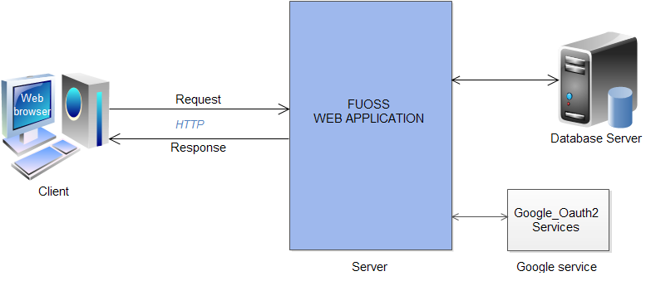
Software design description
Design Overview

Slide 27
Software design description
Packet Organization

Slide 28
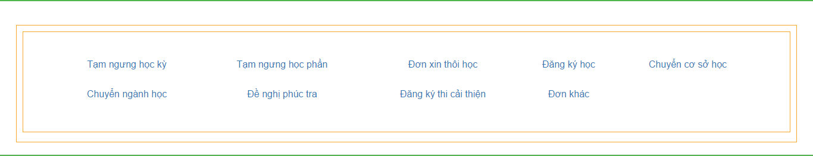
Software design description
index.php

Slide 29
Software design description
Admin login
/admin/

Slide 30
Software design description
Detail
/requests_form/
/Tamngunghocky.php
/Tamngunghocphan.php
/Donxinthoihoc.php
/Dangkyhoc.php
/Chuyencoso.php
/Chuyennganhhoc.php
/Phuctra.php
/Thicaithien.php
/Donkhac.php

Slide 31
/Tamngunghocky.php

Slide 32
/Tamngunghocphan.php

Slide 33
/Donxinthoihoc.php

Slide 34
/Dangkyhoc.php

Slide 35
/Chuyencoso.php

Slide 36
/Chuyennganhhoc.php

Slide 37
/Phuctra.php

Slide 38
/Thicaithien.php

Slide 39
/Donkhac.php

Slide 40
Software design description
Detailed Description of Components
/show_request/
/BM1.php
/BM2.php
/BM3.php
/BM4.php
/BM5.php
/BM6.php
/BM7.php
/BM8.php
/BM9.php
/add_request/
/add.php
/finish.php

Slide 41
Software design description
Sequence Diagrams
Admin search staff
User login
User receive request
Admin search staff
Admin delete staff
User logout
User confirm request
User submit request
Admin add new staff
User approve request
User view request
Admin edit staff role
Admin add new staff
User finish request
User search request

Slide 42
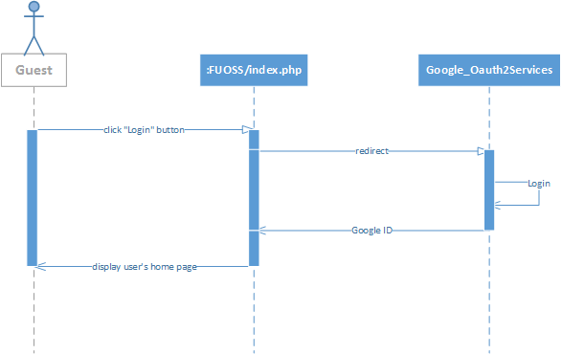
User login

Slide 43
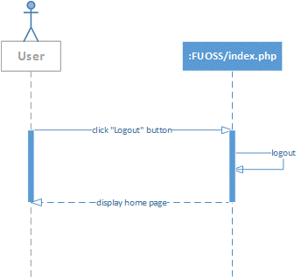
User logout

Slide 44
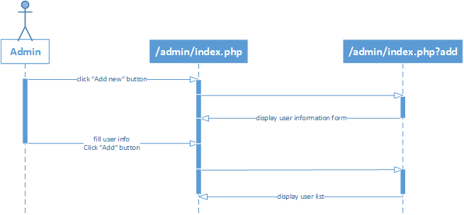
Admin add new staff

Slide 45
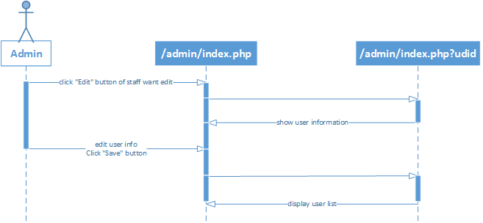
Admin edit staff role

Slide 46
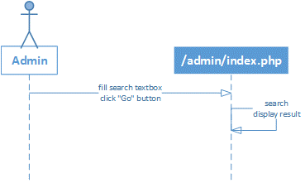
Admin search staff

Slide 47
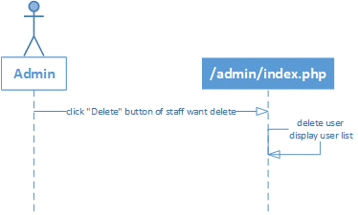
Admin delete staff

Slide 48
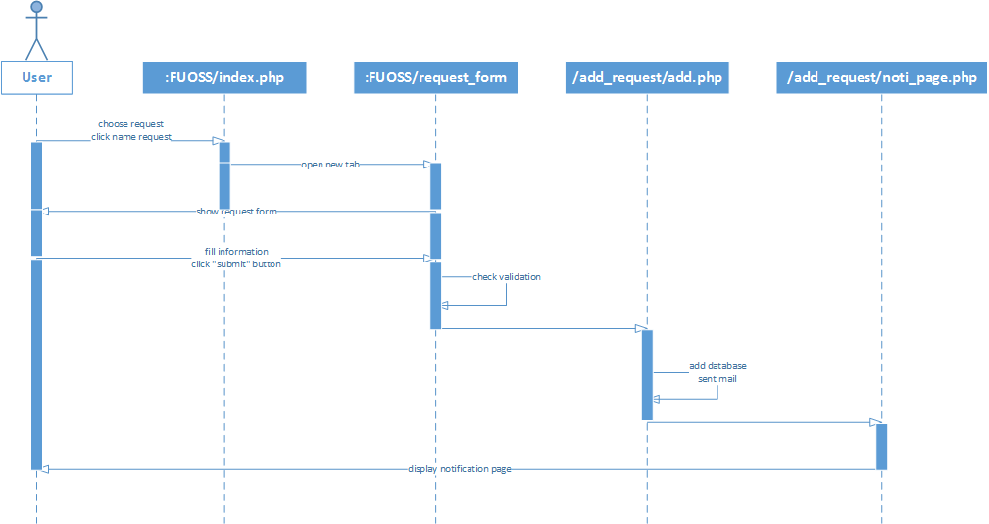
User submit request

Slide 49
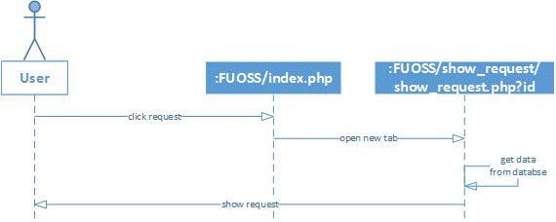
User view request

Slide 50
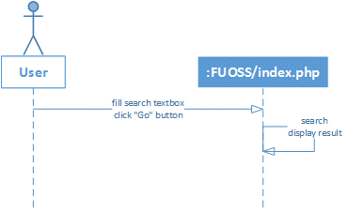
User search request

Slide 51
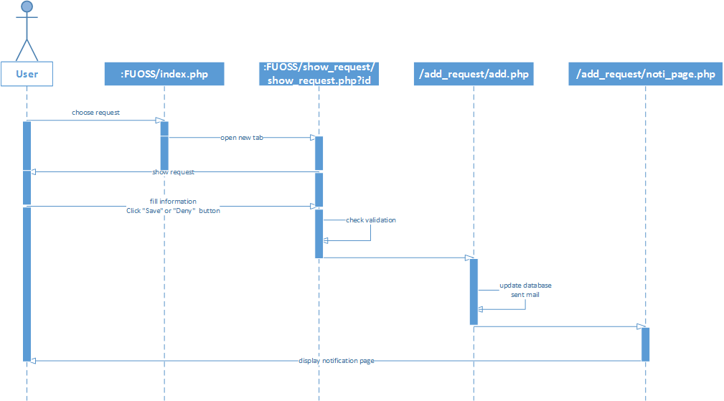
User receive request

Slide 52
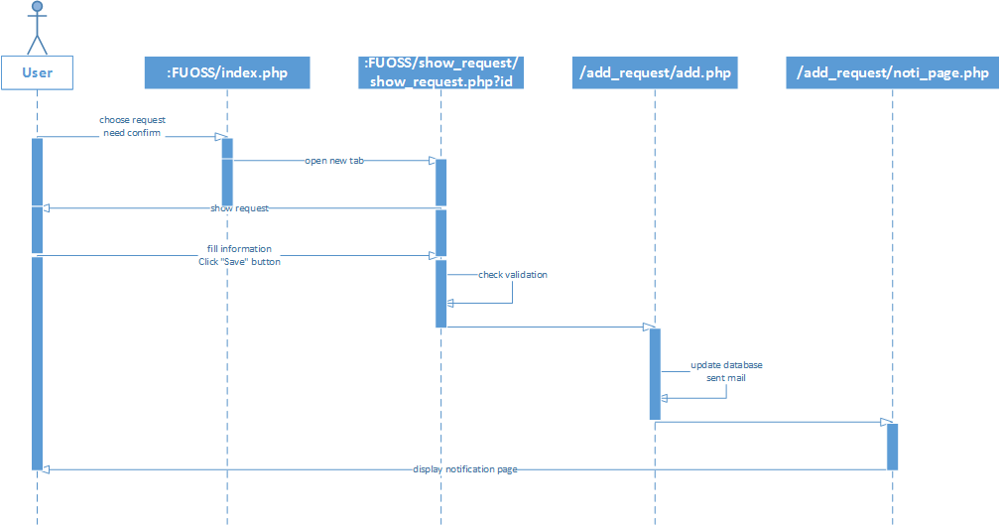
User confirm request

Slide 53

User approve request

Slide 54
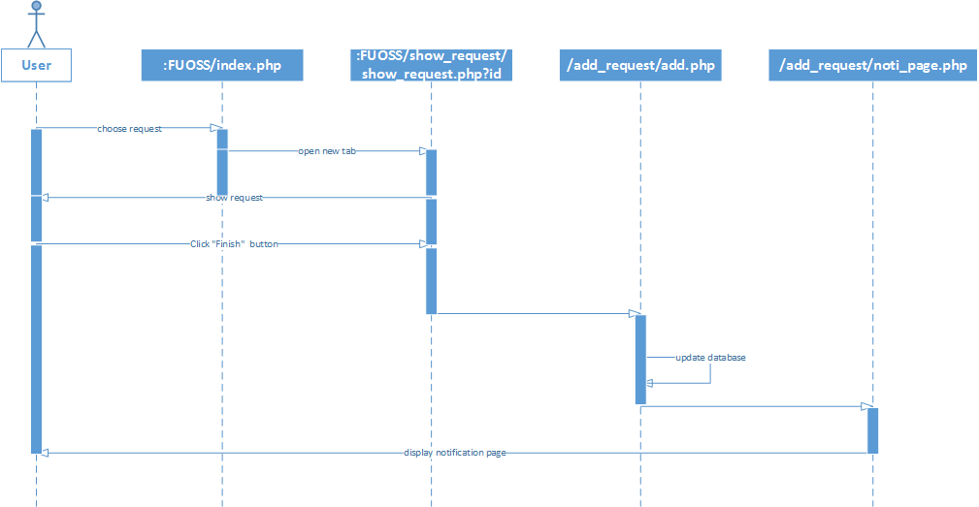
User finish request

Slide 55
Database Design
Software design description

Slide 56

Testing
Test Model
Test Process
Test Cases
Checklists
Notes:
UserRole: ung voi cac nhom nguoi dung cua he thong
Problem:
Di kem voi problem la TestCase
TestCase: la 1 bo input va output tuong ung

Slide 57
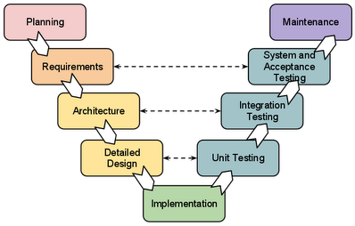
Testing
Test Model

Slide 58
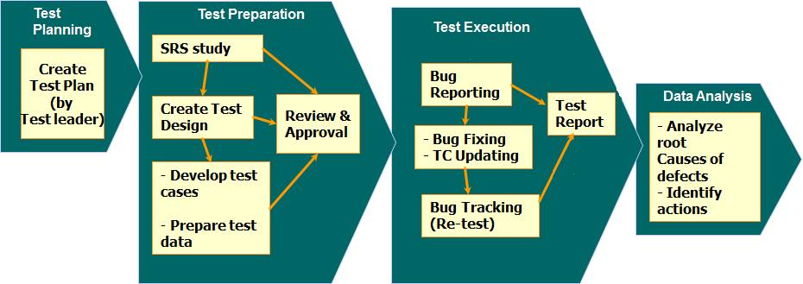
Testing
Test Process

Slide 59
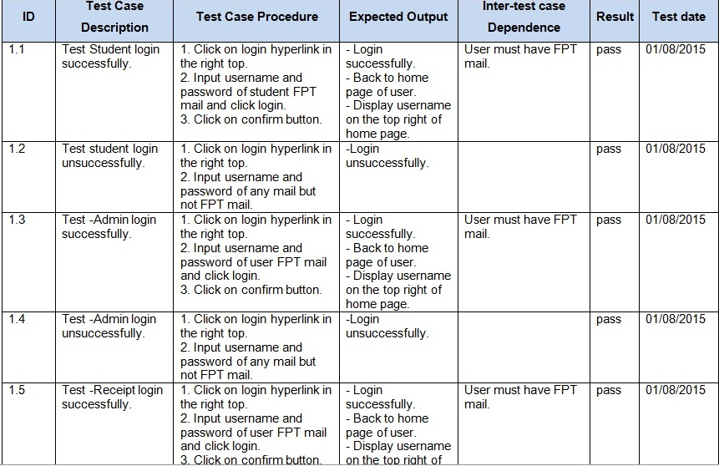
Testing
Test case sample

Slide 60
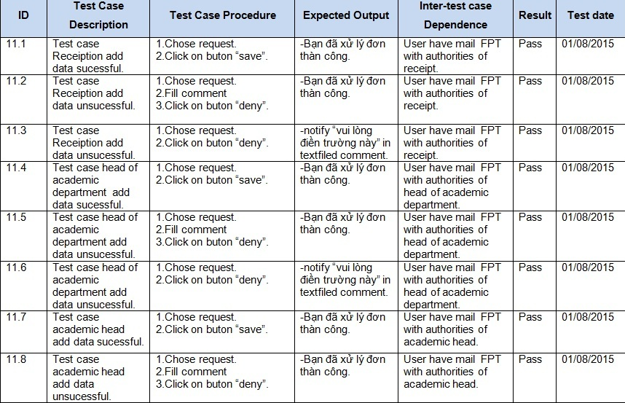
Test case sample
Testing

Slide 61
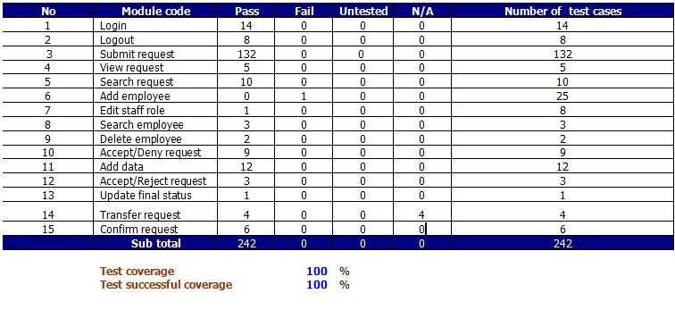
Testing
Report test
Test coverage: 100%
Test successful coverage: 100%

Slide 62
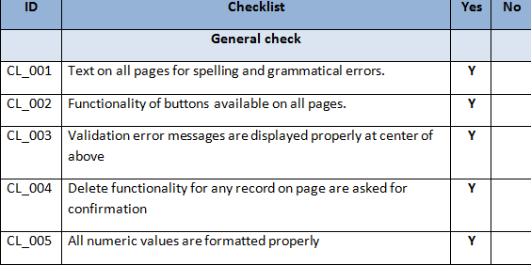
Checklists
5.Testing

Slide 63
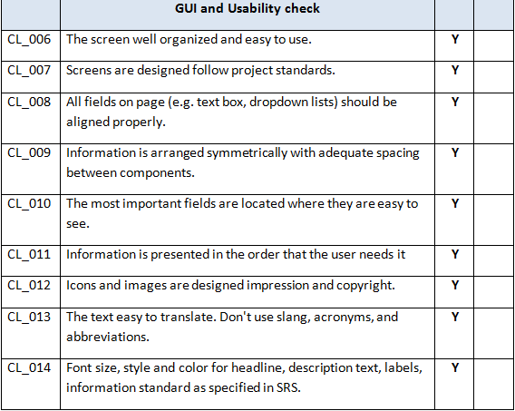
Testing

Slide 64
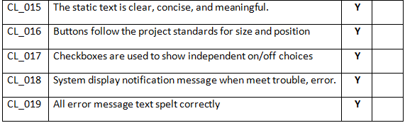
Testing

Slide 65
Demo Product

Slide 66
Thanks for listening

