Slide 1

Accounting Module In ERP
Supervisor: Mr. Nguyễn Hồng Kỳ
Students:
Hoàng Phương Thảo
Tạ Trung Kiên
Nguyễn Tấn Trí
Lưu Hằng My
Nguyễn Văn Tiệp

Slide 2
Contents
Introduction
Project Management Plan
Requirement Specifications
Design Description
Implementation
Test Documentation
Demo & Q&A

Slide 3
Part 1: Introduction
Background
Literature Review
Our Proposal

Slide 4


Background
The management of goods, statistics, accounting…in paper have many disadvantages
Having many popular software which are used to management business through by machine and database.
Development of ERP system
In Vietnam, they still have many limitations.
=> We developed an accounting module in ERP

Slide 5







Literature review

Slide 6

Our proposal
Developing accounting module for the service companies that use ERP system
Building on web-based with advanced technology

Slide 7
Part 2: Project Management Plan
The proposed system
Process
Project organization
Project Planning

Slide 8
The proposed system
User
Functions
System feature
Boundaries

Slide 9
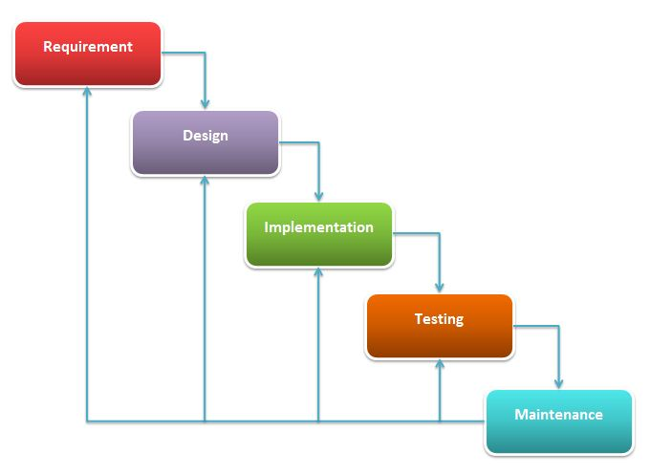
Project’s process model
Waterfall model

Slide 10
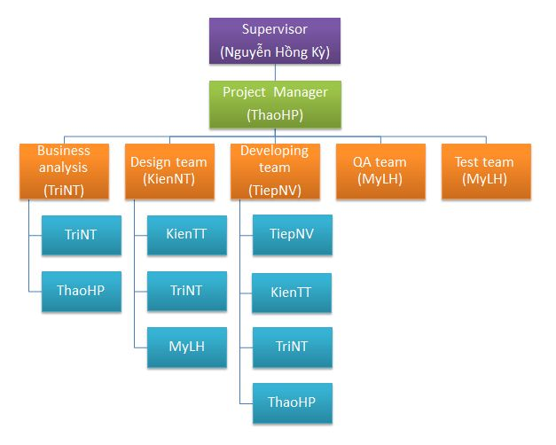
Project organization

Slide 11
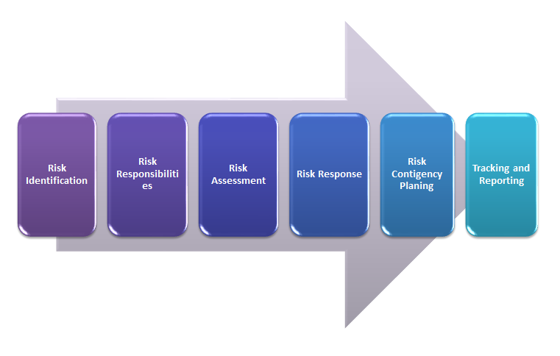
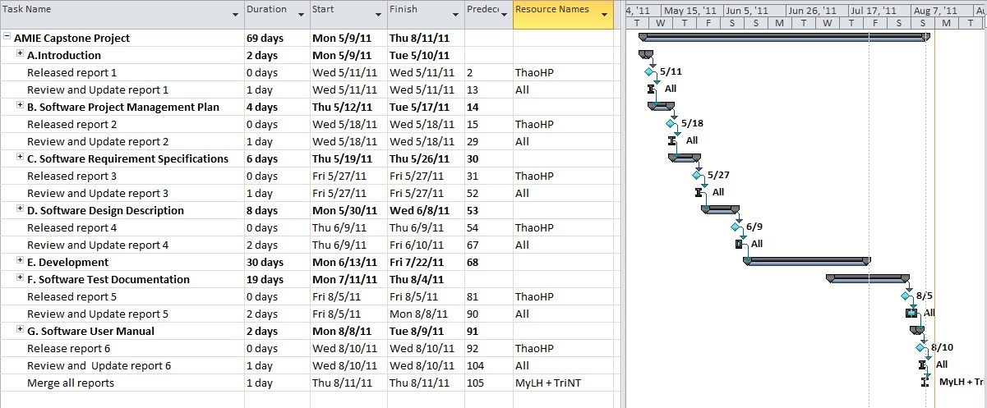
Project Management Plan
Work breakdown structure
Responsibility Assignment Matrix
Risk management plan

Slide 12
Part 3: System Requirement Specifications
User Requirements
System Requirements
Non-functional requirements*

Slide 13
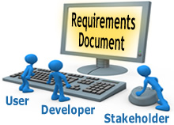
User requirements
Users
Vouchers
Portfolio
General Accounting
Reports

Slide 14
Users
User can add new fiscal year, fiscal period.
User can add new one of portfolios, edit or delete it
User can add new a voucher such as: general voucher, sale invoice, purchase receipt… edit, or delete them
User can access general ledger as “posting balance”, “inventory calculate”…
User can see all another user activity by accessing diary.
User can see all report in the AMIE system and print it if he/she needs.
…

Slide 15
Vouchers
Vouchers
Purchase Receipt
Sale Invoice
Cash Management
General Voucher
If Ledger Date is null, editing and deleting is not available
To view list of voucher which has order by user want. You
can use filler by filling some word on the top of column.

Slide 16
Portfolio
General ledgers list
Partners list
Accounts list
Goods list
Inventory list
Transaction code list
Currency list
Equity category list
Fix asset category list
…

Slide 17
General Accounting
General business operations of the accounting system.
Add new fiscal year, fiscal period
Posting balance
Works was normally conducted at the beginning of fiscal period, year or ending of fiscal period, year.
Calculate total inventory in the end of fiscal period

Slide 18
Reports
Reports have printing function
Report
Balance Sheet
Income statement
General journal

Slide 19
System Requirement
Screen:
Before implementation: created using Balsamiq Mockups software.
After implementation: screenshot from real system

Slide 20
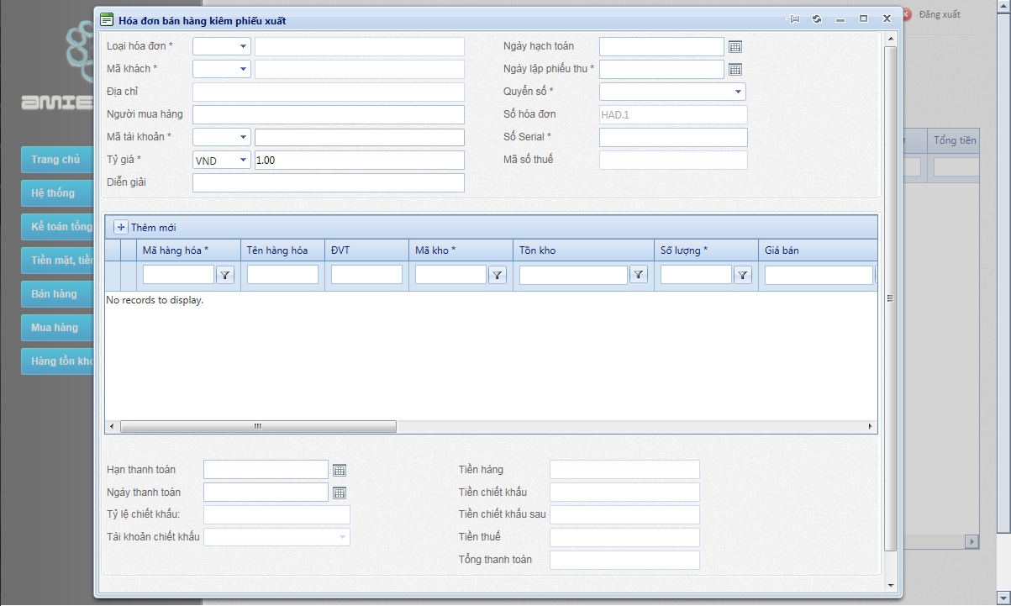
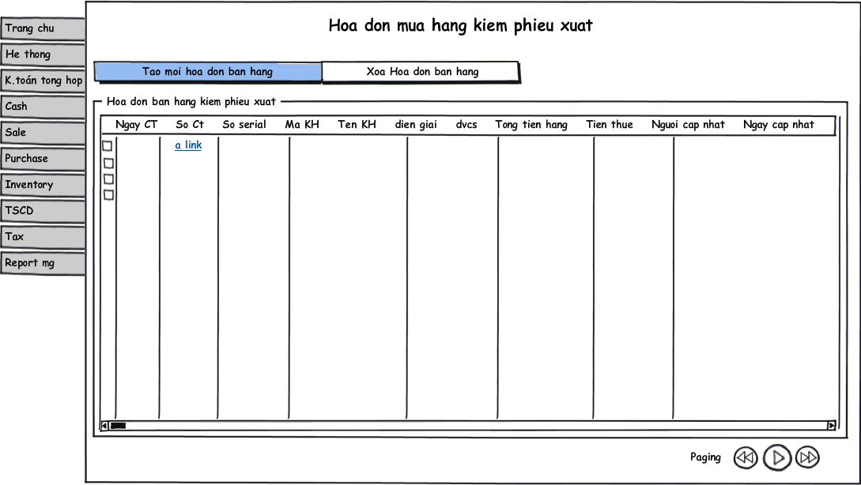
System Requirement
After
Before

Slide 21
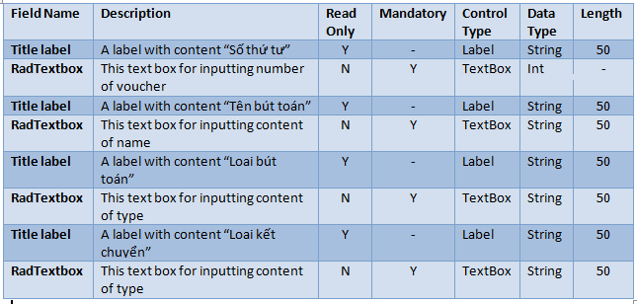
System Requirement
Data Fields Definition:
  Field name
  Description
  Read-only
  Mandatory
  Control type
  Data type
  Length

Slide 22


Non-functional requirements
Usability
Reliability
Availability
Security
Maintainability
Performance

Slide 23
Part 4: Software Design Description
Architectural design
Detailed design
Database design

Slide 24
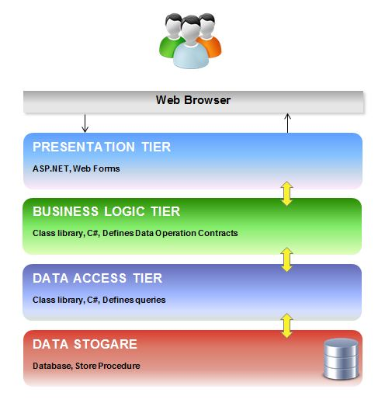
Architectural design

Slide 25
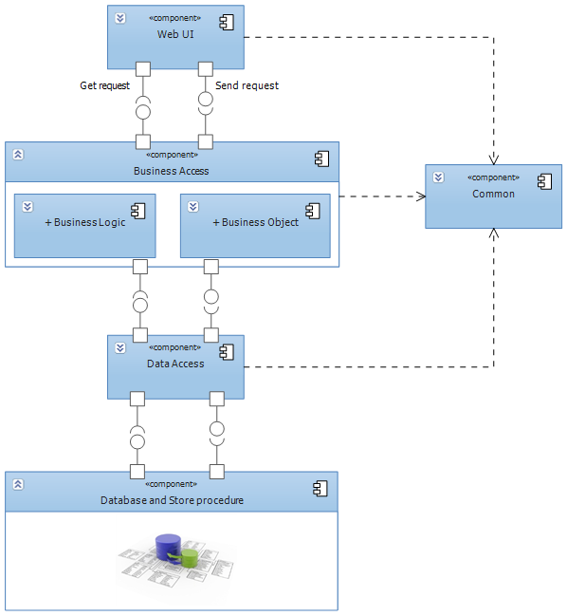
Architectural design
Main components

Slide 26
Detailed design: Class Diagram

Slide 27
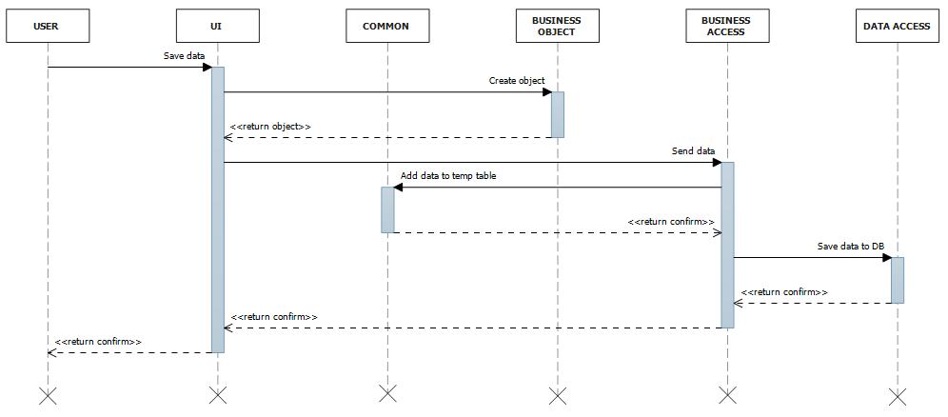
Detailed design: Sequence Diagram

Slide 28
Database design
Business tables
Support tables: Temp table, virtual table…
Every table has a primary key named Id which is of type: int not null identity(1, 1)
Max length and nullability strictly follow field definitions
Database has 6 common columns: IsActive, RegistedDate, RegisterID, UpdateDate, UpdateUserID, UpdateCount
UpdateCount column has defaul data is 0
Every business table will have the trigger to save all the table changing.

Slide 29
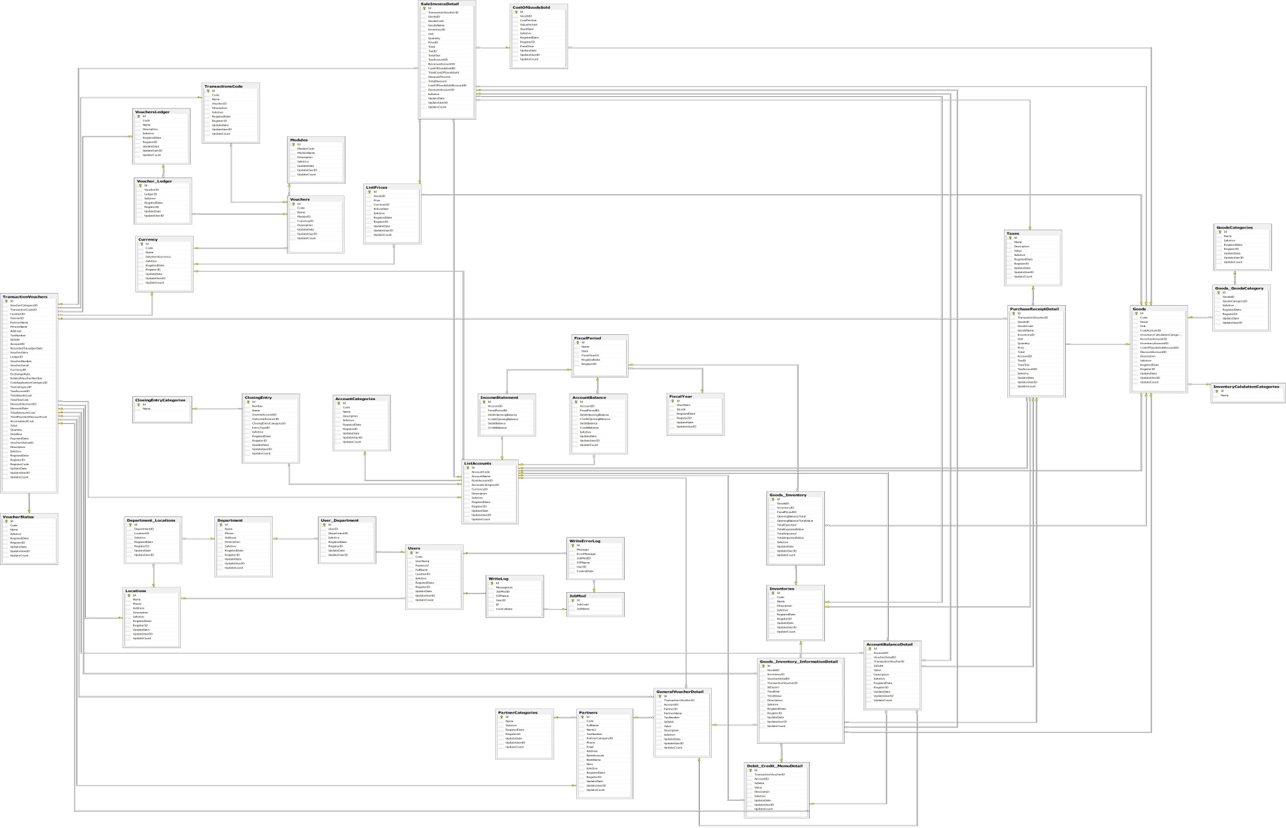
Database design

Slide 30
Part 5:Implementation
Technologies
Tools
Coding convention
Code review
Unit test
Security considerations

Slide 31




Technologies
.NET Framework 4
SQL Server 2008
RadControls for ASP.NET AJAX
jQuery

Slide 32




Tools
Visual Studio 2010
Resharper
SQL Prompt
TortoiseSVN
…..

Slide 33
Coding conventions
Follow general .NET coding conventions
e.g. Pascal Casing, Camel Casing…
Create specific conventions for the project

Slide 34

Code Review
By technical lead
Peer review

Slide 35
Unit Test
Mainly for business access tier & data access tier
Using NUnit
Not done:
Create NUnit report

Slide 36
Security considerations
Client side and server side validation
No SQL injection
Encrypt sensitive data:
  Password
  Cookies

Slide 37
Part 6: Testing
Include:
  Test plan
  Bug control
  Test report

Slide 38
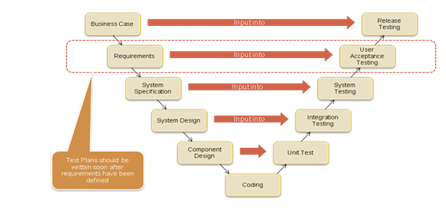
Testing phase

Slide 39
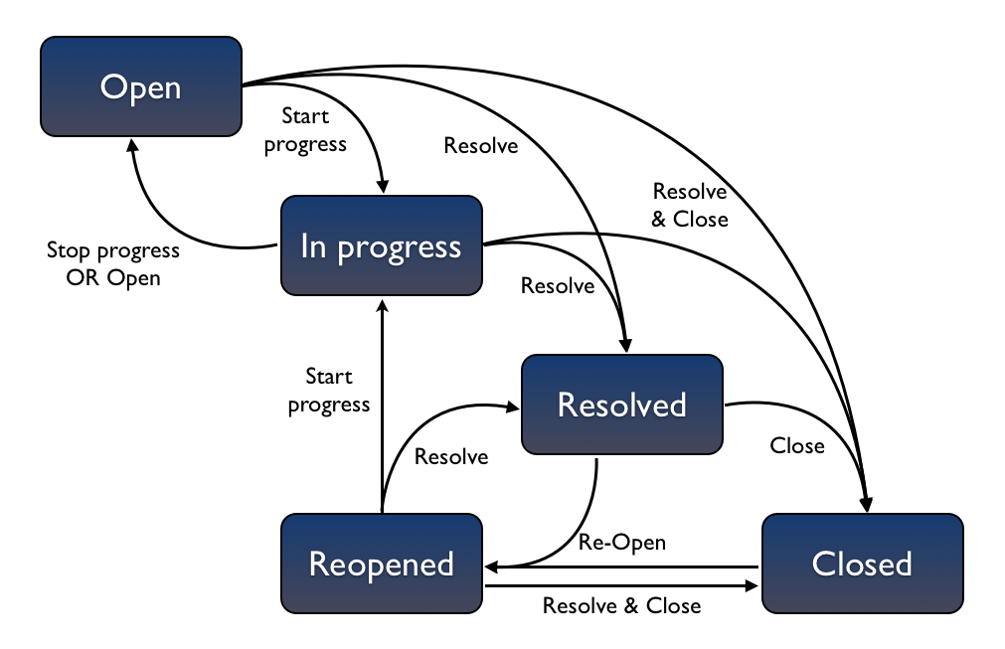
Part 6: How to test

Slide 40
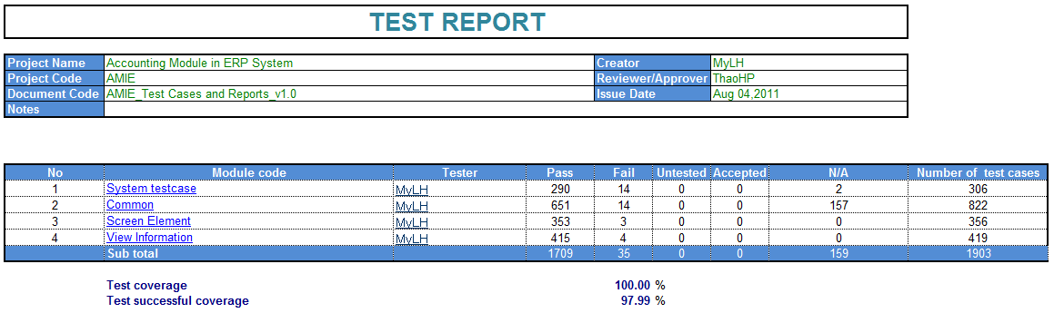
Test Report

Slide 41
Part 7: Demo & Q&A
Demo - Q&A

Slide 42
Thank You !

