Slide 1
Online Dating Network
Mr. Nguyễn Hồng Kỳ
(Supervisor)
1. Ngô Thành Vinh
2. Cao Minh Hậu
3. Nguyễn Thanh bằng
4. Nguyễn việt thắng
5. Lê Minh đức
6. Vũ văn nam

Slide 2
  Demand
  Weaknesses of existent websites
DO Project
  A new idea for the old problem

Slide 3
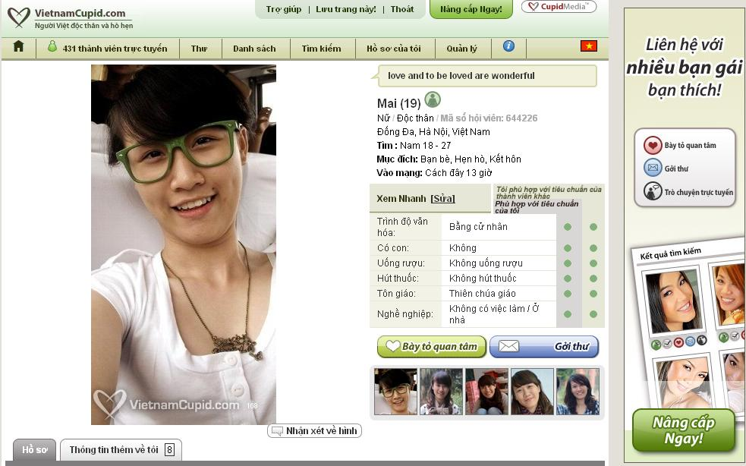

Slide 4
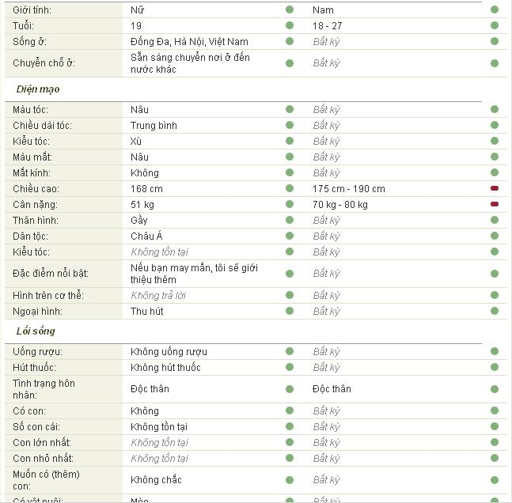

Slide 5
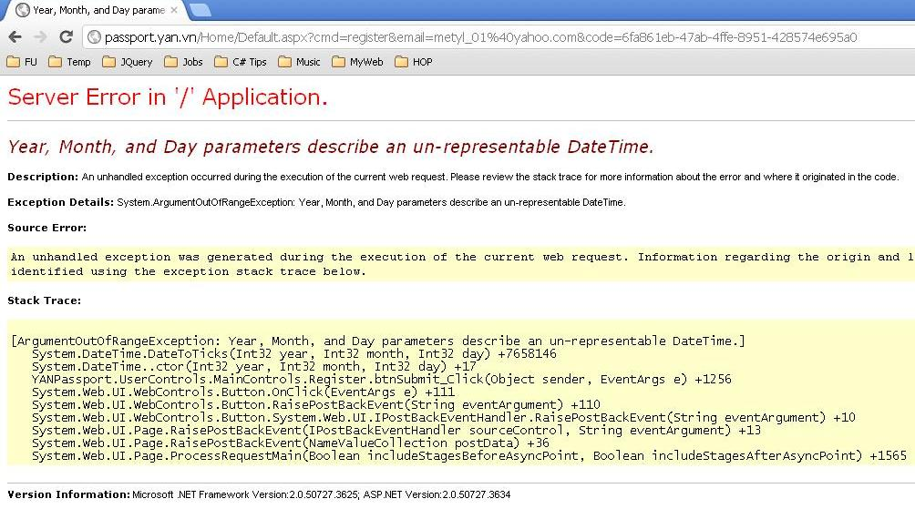

Slide 6
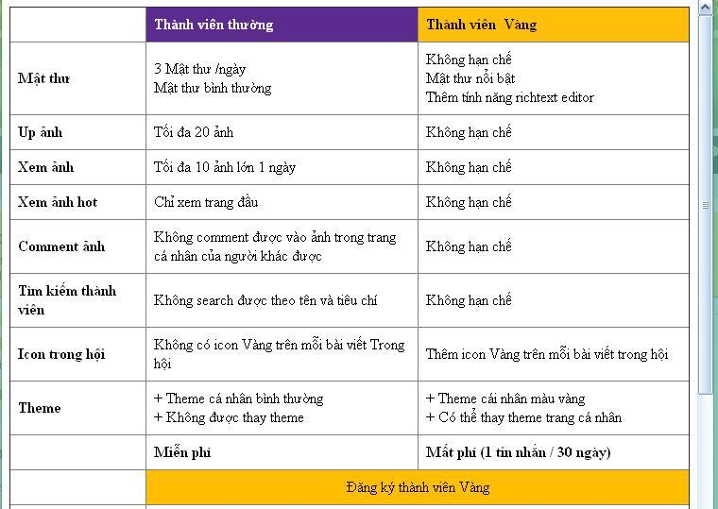

Slide 7
Demo

Slide 8
Team member
&
Roles

Slide 10
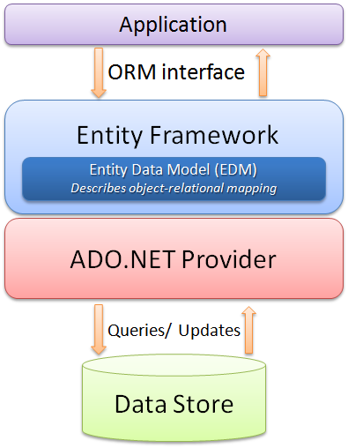

Slide 11
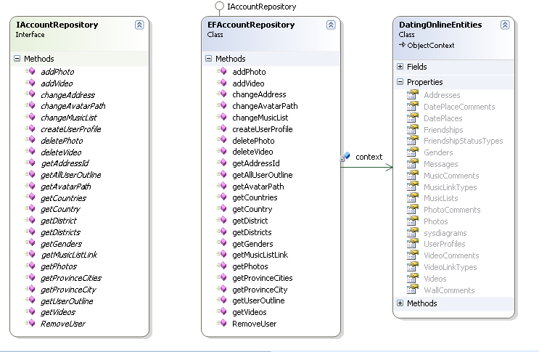

Slide 12
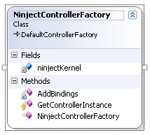
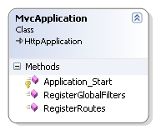


Slide 13
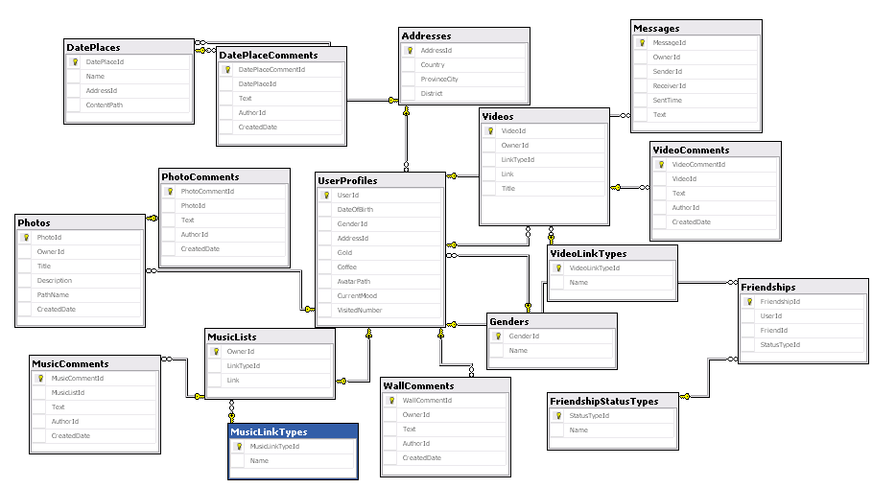

Slide 14


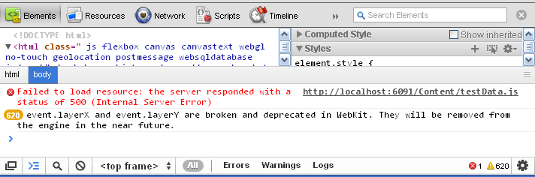


Slide 15





Slide 16
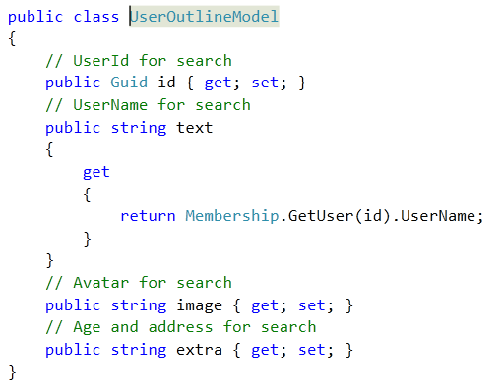

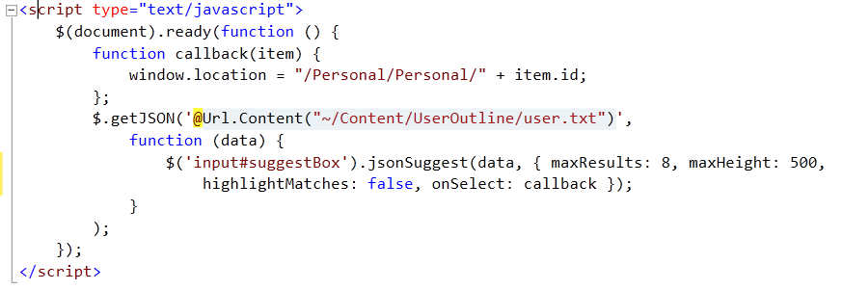
50.000

Slide 17
Photo process
ADD
Thumb
Resized
VIEW
jquery.lightbox-0.5.js

Slide 18

Video & Music
Process
@"^((http://)?(www\.)?nhaccuatui\.com/nghe\?L=)([A-Za-z0-9_-]+)"
@"^((https?://)?(www\.)?youtube\.com/watch\?v=)([A-Za-z0-9_-]+)&?"

Slide 19
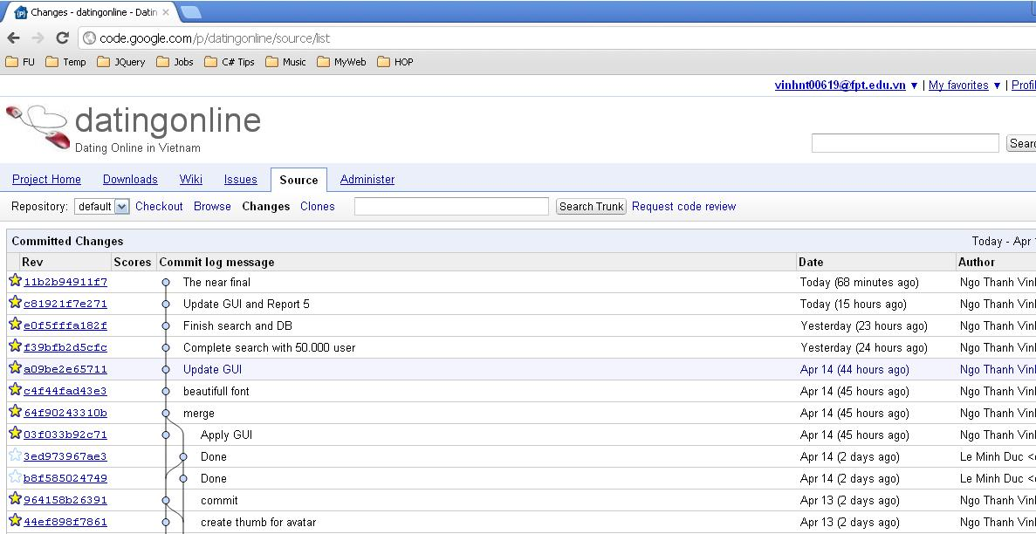

Slide 20

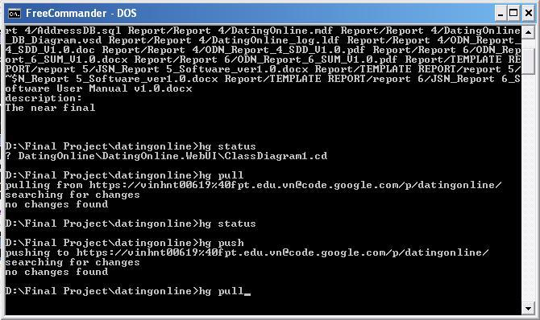

Slide 21
DEMO FOR Q&A

Slide 22
Thank you

