Slide 1


Capstone Project
Hanoi - December 2012

Slide 2
Project Team
Supervisor:
Mr. Nguyen Hong Ky
FLIS Team:
Pham Hoang Phuong - 00796
Chu Dinh Nam - 01208
Pham Van Quyen - 00958
Hoang Thi Khanh Hoa - 01459
Ngo Duy Thuy Nuong - 01415

Slide 3
Agenda
Introduction
Project Plan
Requirements
Design and Implementation
Testing
Demo and Q&A

Slide 4
Introduction

Slide 5
FPT Library
  A huge library system :
    A large amount of books and learning materials
    A large amount of readers
    Many book databases : Libol, Emerald, Books24x7

Slide 6
Existing
Systems

Slide 7
An Overview
FPT University
Library
Libol
Emerald
News
Internal book database
Books24x7
Inside CMS
External book database

Slide 8
Drawbacks
  The existing systems have many drawbacks :
    The news site is complex
    External book databases are separated
    Internal book database is unattractive and error

Slide 9
Drawbacks
  User must search for information from many sites:
News
User
Internal Resources
External Resources
Take time and frustrating!

Slide 10
Initial Idea

Slide 11
  Integrated Database
  Information System
  A system which supports user to:
    Update news
    See available library resources :
      Internal resources
      External resources
    Implement multi-search (search books in various databases)
    Request for books

Slide 12
  Integrated Database
  Information System
  Information is gathered into one site
News
User
The new system
Internal Resources
External Resources

Slide 13
Project
Plan

Slide 14
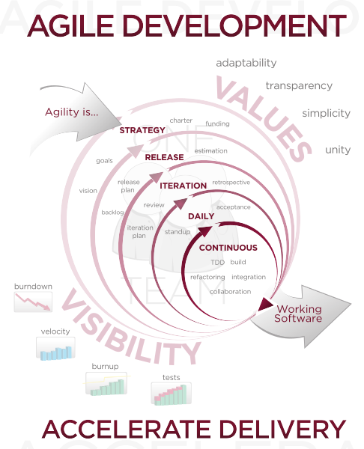
Project Plan
Process model
Agile model

Slide 15
Project Plan
Project Organization
No | Name | Role
1 | Pham Hoang Phuong | Project Manager/ Developer
2 | Chu Dinh Nam | Developer/ Technical Leader
3 | Pham Van Quyen | Designer/ Developer
4 | Hoang Thi Khanh Hoa | QA and Tester
5 | Ngo Duy Thuy Nuong | QA and Tester

Slide 16
Project Plan
Project Plan
The project is planned to run in 16 weeks, include:
Analyzing Issue: 1 weeks
Collecting Requirements: 2 weeks
Designing: 3 weeks
Coding: 6 weeks
Testing: 8 weeks
Summarizing: 2 weeks

Slide 17
Project Plan
Technologies and Tools
Tool for coding:
Microsoft Visual Studio 2010
Asp.net mvc3 tool
Database system:
Microsoft SQL 2008
Program language:
Server/client program: ASP.NET MVC3 model
Website for user to operate: ASP.NET
Database query language: Microsoft SQL
Website interface: CSS, JavaScript, Jquery
Other:
.NET framework 4.0
Microsoft Office 2010
Microsoft Project 2010

Slide 18
Requirement
Specification

Slide 19
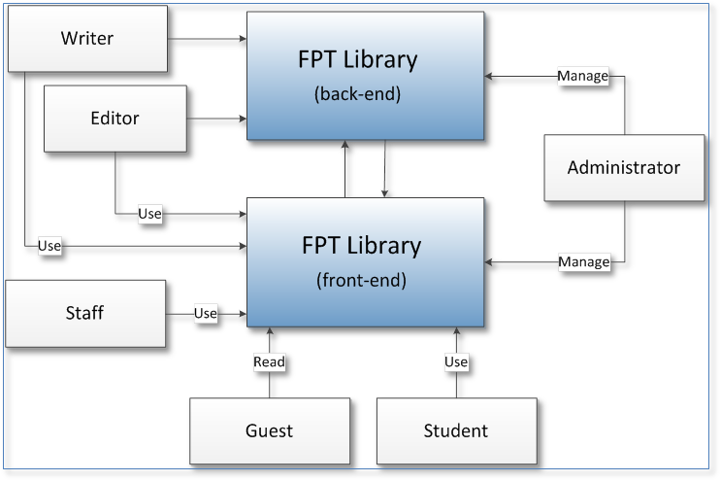
Requirement Specification
System Overview

Slide 20
Requirement Specification
Book Management

Slide 21
Requirement Specification
Article Management

Slide 22
Requirement Specification
Article Management

Slide 23
Requirement Specification
Non-functional Requirements
Website language: Vietnamese
UI: elegant, attractive
The proposed system response time of less than 7 seconds
Database and files: backed up regularly
Privacy: protect user information
User password must be encrypted
(refer 1.1.3 Software System Attributes in Report)

Slide 24
Design and
Implementation

Slide 25
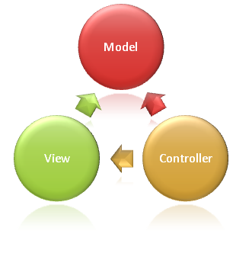
Design and Implementation
Choice of System Architecture
MVC Model
Notes:
Gioi thieu thiet ke tong quan: mo hinh n tiers
Bao gom phone & web client
Web server – REST tier, Business tier, DAL tier
Su dung apache tomcat cho web hosting & MySQL cho coso du lieu
HTTPS cho viec giao tiep thong tin o cac phan nhay cam nhu thong tin nguoi dung, kiem tra don hang

Slide 26
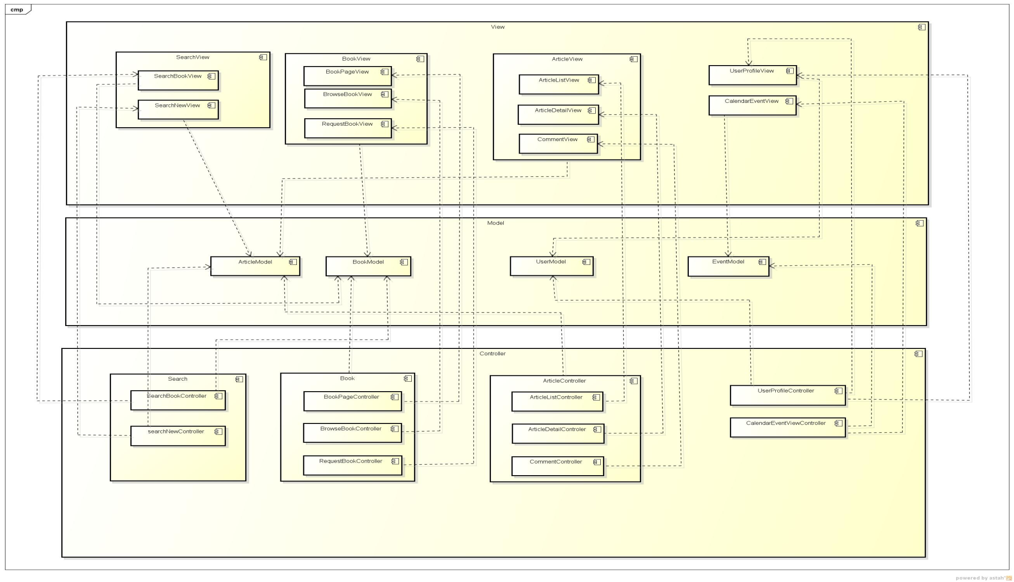
Design and Implementation
Front end
Notes:
Web server & Web client:
Web server gom 3 thanh phan chinh: REST layer, phuc vu cho viec trao doi thong tin voi phone client
Business layer: xu li cac nghiep vu lien quan den logic
DAL layer: truy xuat du lieu tu db thanh cac doi tuong (entity o ben) va tra ve cho business layer theo yeu cau
Prefer composition over inheritance, VD:
- UserBusiness se co instance cua interface UserDAL -> viec thay doi implementation cua UserDAL se k anh huong den tang business
Spring container co tac dung thuc hien dependency inject, khi khoi tao 1 doi tuong co field co class la UserBusiness, Spring container se kiem tra neu doi tuong da duoc khoi tao, neu chua -> khoi tao theo config trong xml sau do inject vao doi tuong dang duoc khoi tao

Slide 27
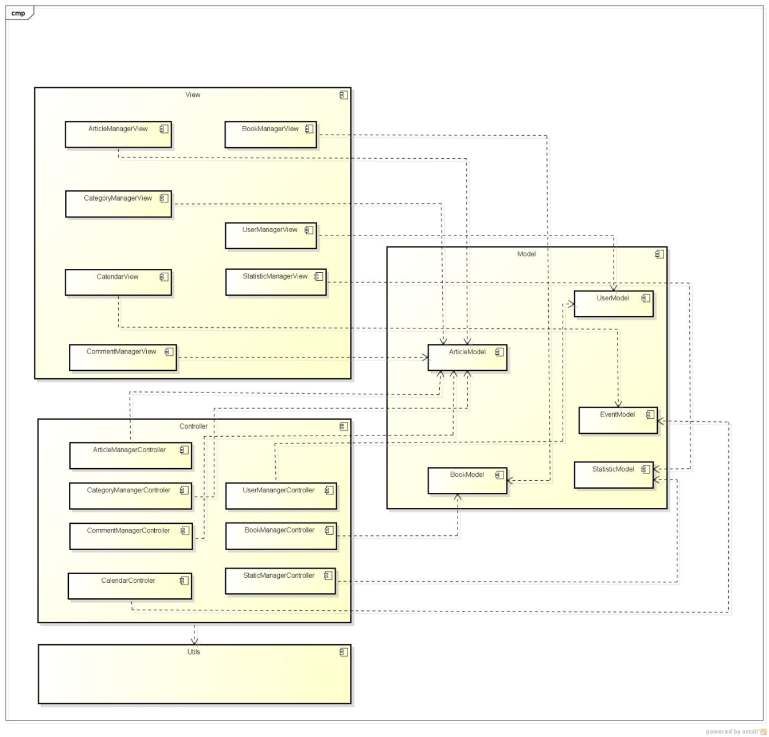
Design and Implementation
Back end
Notes:
Web server & Web client:
Web server gom 3 thanh phan chinh: REST layer, phuc vu cho viec trao doi thong tin voi phone client
Business layer: xu li cac nghiep vu lien quan den logic
DAL layer: truy xuat du lieu tu db thanh cac doi tuong (entity o ben) va tra ve cho business layer theo yeu cau
Prefer composition over inheritance, VD:
- UserBusiness se co instance cua interface UserDAL -> viec thay doi implementation cua UserDAL se k anh huong den tang business
Spring container co tac dung thuc hien dependency inject, khi khoi tao 1 doi tuong co field co class la UserBusiness, Spring container se kiem tra neu doi tuong da duoc khoi tao, neu chua -> khoi tao theo config trong xml sau do inject vao doi tuong dang duoc khoi tao

Slide 28

Design and Implementation
Multi-Database Book Search Solution
Web Crawler:
Use automatic web crawlers to get information from book databases
Save information on cache databases
User can search on cache databases
Quick and stable
Notes:
Di vao phan thuat toan
Gioi thieu ki hon ve cac thanh phan tren QR code: finder pattern…

Slide 29
Design and Implementation
Multi-Database Book Search Solution
Cache Database
Crawler
Libol
User
Cache Database
Crawler
Emerald
Cache Database
Crawler
Books24x7
Notes:
Di vao phan thuat toan
Gioi thieu ki hon ve cac thanh phan tren QR code: finder pattern…

Slide 30
Testing

Slide 31
Testing
Include
Testing process
Test execution
Define Testing
Test case
Test report
Test Strategy

Slide 32
Testing
Define Testing
Testing Goals:
  Identify risks and prevention actions to warrantee the successful completion of the project.
  Verify functional correctness
  Testing will detect the errors, in the aim of ensuring product is the best, fastest, most stable

Slide 33
Testing
Test Strategy
Release Planing
(Test Plan)
Each Sprint
(Sprint QA activities)
System Test
Release QA actvities

Slide 34
Testing
Test Process
Add a Test
Run the Test
Pass
Fail
Make a litte change
Run the Test
Fail
Pass
Refactor

Slide 35


Testing
Test execution
    Unit test
    Function test
    Integration test
    System test
    Acceptance test
Performance test

Slide 36
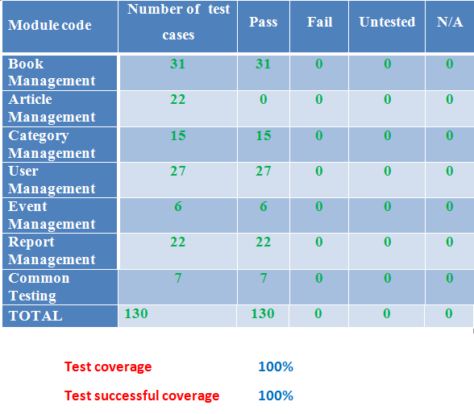
Testing
Test Result

Slide 37
Lesson Learned

Slide 38
Result and Future
Requirement specify
Project management
Team work

Slide 39
Future Plan

Slide 40
Result and Future
Expand the system : add 1 more book database
User can read as well as download book

Slide 41
Demo

Slide 42
Q&A

Slide 43
THANK YOU

