Slide 1
WHERE TO TRAVEL
Capstone Project

Slide 2
Content
Introduction
Project Management Plan
Requirement Specification
Design Description
Implementation
Testing
Summary
Demo & Q&A

Slide 3
Introduction
People
Background
Existing System
Trending
Proposal
Scope

Slide 4
People
Hoang Van Dong
PM & Technical Leader
Trinh Trung Kien
Developer & CM
Mr. Bui Dinh Chien
Instructor
Nguyen Thi Thu Trang
Test Lead
Hoang Minh Nhat
Developer & QA
Nguyen Van Khanh
Developer & Tester

Slide 5
Background
Search for “dia diem” keyword

Slide 6
Background
Search for “dia diem” keyword

Slide 7
Idea
Create an Sharing Location Mobile Application
Trend to user

Slide 8
Existing System

Slide 9
Google Place
Focus only for owners business
No tip, no recommend
Not fully supported in Vietnam
Some people don’t know it (almost Google Search and Gmail)

Slide 10
thodia.vn
A place sharing of Vietnamese with big data
Almost in Ho Chi Minh City
Not fully supported in Mobile application

Slide 11
Foursquare
Best sharing places on Mobile Application on the world.
Lots of functions, easy to use and flexible
Expanding in Vietnam

Slide 12
Proposal
Specialized for Vietnamese users and Vietnamese addresses.
Support interacts with Facebook to easy to find friends.
Based on iPhone will makes system popular and easy to use .

Slide 13
Scope
Back-end Website
iPhone App

Slide 14
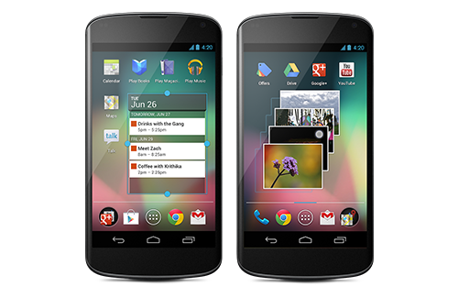
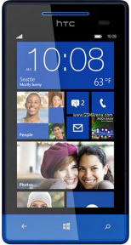
Out of Scope
Android
Window Phone

Slide 15
Content
Introduction
Project Management Plan
Requirement Specification
Design Description
Implementation
Testing
Summary
Demo & Q&A

Slide 16
Project Management
The purposed system
Development Environment
Process
Project Organization
Project Plan

Slide 17
The purpose of system
Easy to use
Attractive
Big Data
Trend to user
Available 24/24

Slide 18
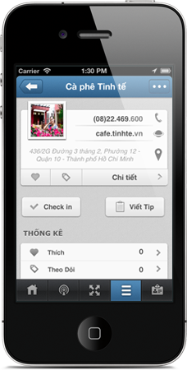
The purpose of system
iPhone Application
View, search location information
Check in, share tip, image, new location
Search, like, follow, evaluate location
Explorer based on current location
Find, follow friend activities
Get trending and recommendation

Slide 19
The purpose of system
Back-end
View statistic
Manage Users, User Level
Manage Location, Location Category
Manage Report Spam

Slide 20
The purpose of system
iTravel

Slide 21
Development Environment
Mac OS 10.7
Xcode 4
Eclipse
PHP 5 & MySQL
MAMP

Slide 22
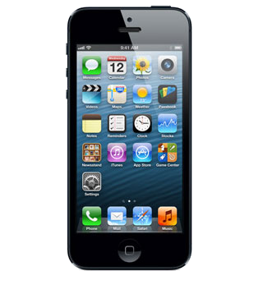
Deployment Environment
Apache Server
iPhone

Slide 23
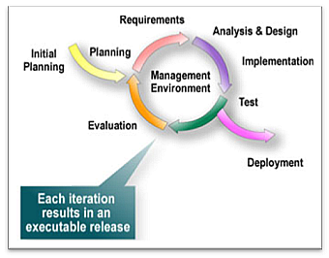
Process

Slide 24
Project Organization
Hoang Van Dong
PM
Hoang Van Dong
Tech Lead
Nguyen Thi Thu Trang
Test Lead
Hoang Minh Nhat
QA
Trinh Trung Kien
Developer
Nguyen Van Khanh
Developer
Hoang Minh Nhat
Developer
Nguyen Van Khanh
Tester
Hoang Minh Nhat
Tester
Trinh Trung Kien
Tester
Hoang Van Dong
Tester
Hoang Van Dong
Designer

Slide 25
Project Planning
Follow Capstone Project requirement
Submit all report on time

Slide 26
Content
Introduction
Project Management Plan
Requirement Specification
Design Description
Implementation
Testing
Summary
Demo & Q&A

Slide 27
Requirement Specification
User Requirement
System Requirement
Non-function Requirement

Slide 28
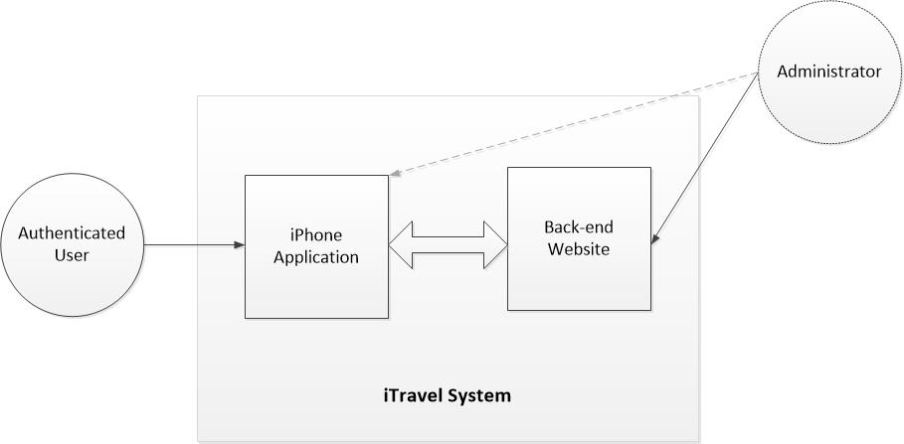
User Requirement

Slide 29
Main Functions (1)
Sign up/Sign in/Account management
Sharing location/tip
Check in/follow/comment location
Push notification
Reporting spam
Voting (Location/Tip/User wall post)
Create new location

Slide 30
Main Functions (2)
Searching user/location
Recommendation (User rating/Trending)
Survey (Location)
User Management
Place/Location Management
Statistic

Slide 31
System Requirement

Slide 32
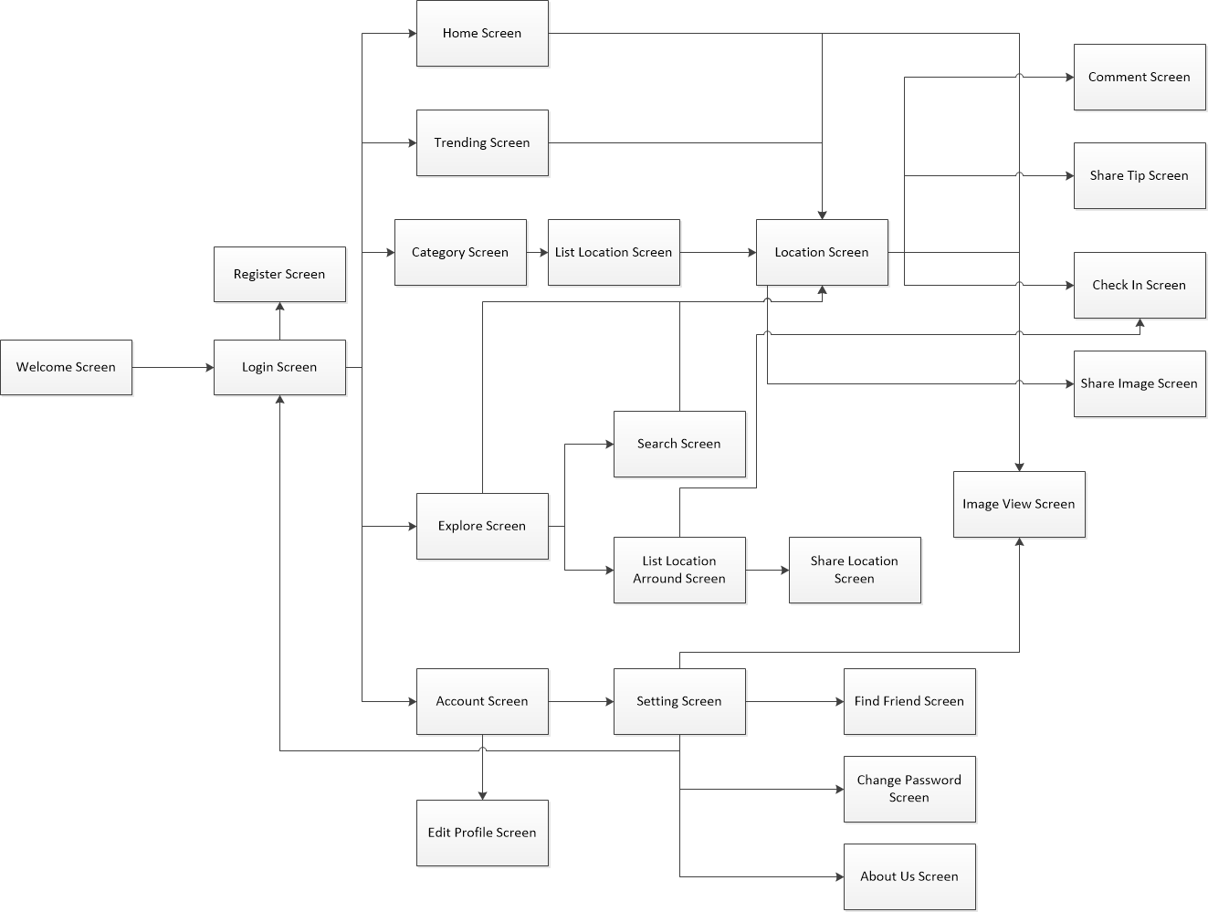
Client Flow

Slide 33
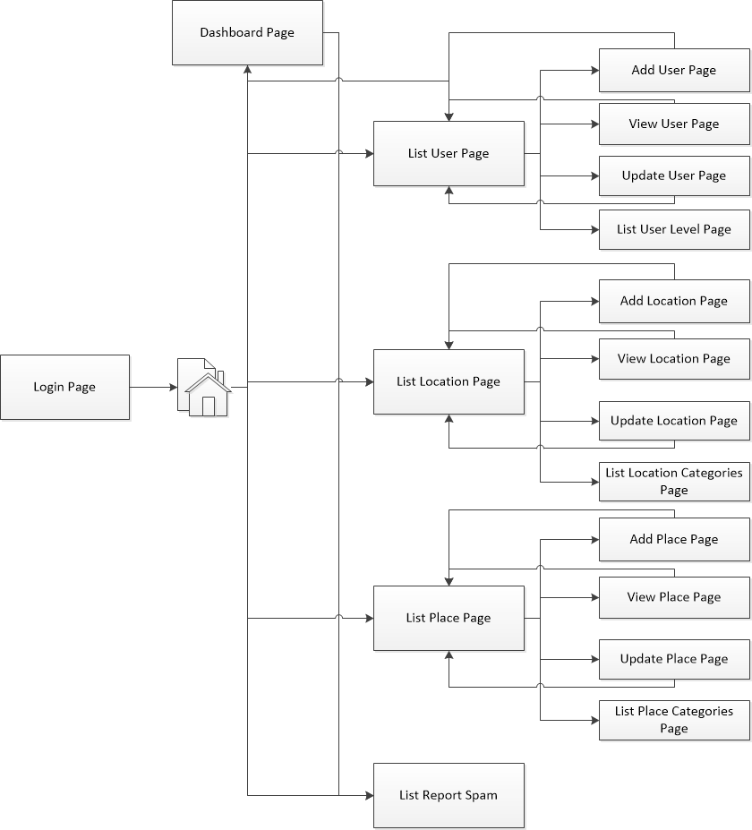
Server Flow

Slide 34
Non-function Requirement
Reliability
Availability
Security
Maintainability
Portability
Performance

Slide 35
Content
Introduction
Project Management Plan
Requirement Specification
Design Description
Implementation
Testing
Summary
Demo & Q&A

Slide 36
Design Description
System Architectural Design
Component
Database Design

Slide 37
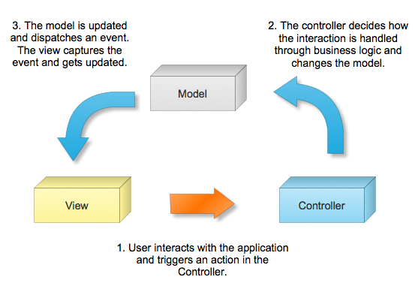
System Architectural Design

Slide 38
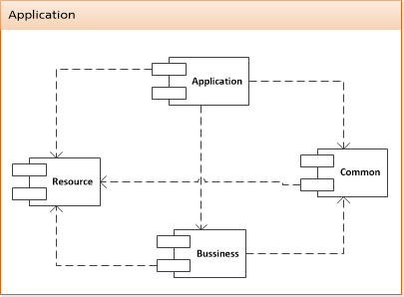
Component

Slide 39
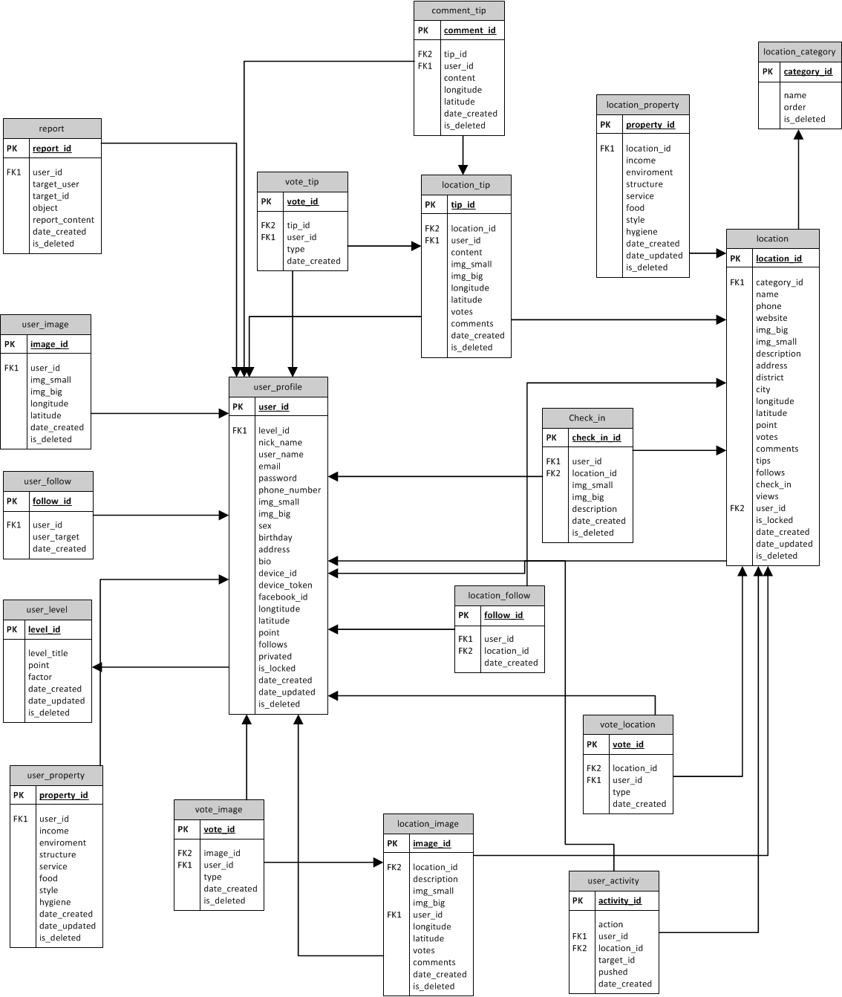
Database Design

Slide 40
Content
Introduction
Project Management Plan
Requirement Specification
Design Description
Implementation
Testing
Summary
Demo & Q&A

Slide 41
Implementation
Technologies
Tools
Coding Convention
Coding Review
Performance
Security

Slide 42
Development Environment

Slide 43
Hardware
iPhone

Slide 44
Coding Convention
Follow Objective-C Coding Conventions of Apple
Follow general PHP Conventions

Slide 45
Coding Review
By Technical Leader
Peer Review

Slide 46
Performance Considerations
Minimize requests to server and database hit
Using JSON to transfer data.
Cache images.
Background request.

Slide 47
Security Considerations
Client and server validation
No SQL Injection
Encrypt sensitive data
Not done
Avoid DDOS attack
Using SSL

Slide 48
Content
Introduction
Project Management Plan
Requirement Specification
Design Description
Implementation
Testing
Summary
Demo & Q&A

Slide 49
Testing
Test plan.
Expected number of test case and bugs.
Test tool and environment.
Checklist.

Slide 50
Content
Introduction
Project Management Plan
Requirement Specification
Design Description
Implementation
Testing
Summary
Demo & Q&A

Slide 51
Summary
14/12 published to Apple Store
5 rating (5 starts)
More than 100 download
Future
Continue developing
Invest in this product

Slide 52
Content
Introduction
Project Management Plan
Requirement Specification
Design Description
Implementation
Testing
Summary
Demo & Q&A

Slide 53
Demo & Q&A

