Slide 1

Toll Fee Management
Supervisor : Nguyễn Văn Sang

Slide 2
Contents
Toll Fee Management
1
Introduction
2
Project Management
3
Architectures & Technology
4
Project Result
5
Demonstration
5

Slide 3
Part 1 : Introduction
Toll Fee Management
Group’s member
Current Situation
Ideas Project Approach
System Overview
Function Overview

Slide 4
Group’s member
Toll Fee Management
Supervisor | Mr. Nguyễn Văn Sang Mr. Huỳnh Anh Dũng Mr. Nguyễn Tất Trung
Name | Student ID
Trần Hải Đăng | 00357
Nguyễn Xuân Hiếu | 00380
Tô Văn Quân | 00425
Nguyễn Anh Nhật Linh | 00499
Nguyễn Duy Vũ | 00521

Slide 5
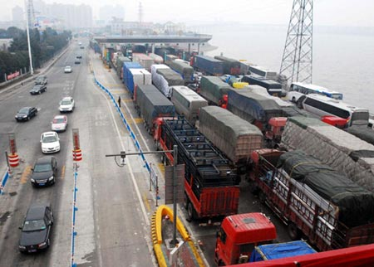
Current Situation
Toll Fee Management
Traffic jam frequently occurs at the toll booth traffic
Take a lot of time for buying ticket and checking ticket
Difficulties in management and vehicle traffic statistics

Slide 6
Ideas Project Approach
Toll Fee Management
Existing method for automatic toll collection
Reduce operational cost
Easy management
Fast transaction
Market competition
Online Services

Slide 7
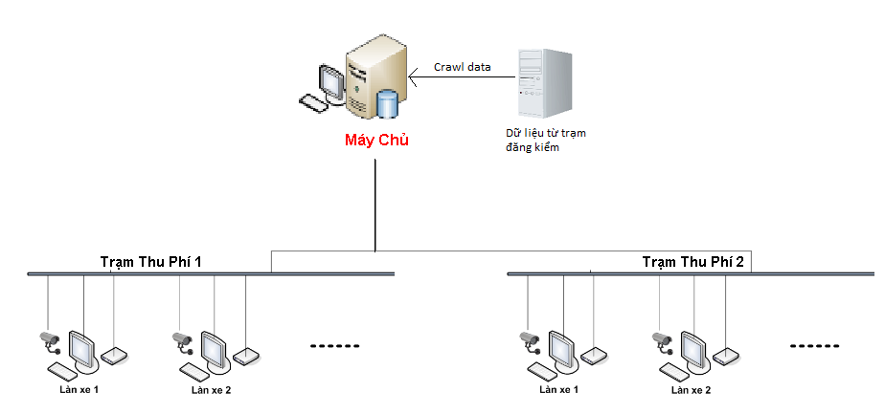
System Overview
Toll Fee Management

Slide 8
Function Overview
Toll Fee Management
Auto number plate recognition
Report for manager review activities of each station
Synchronize data between local database and Vietnam Register System’s database
Toll collection : monthly or times

Slide 9
Objectives
Understand software process model in accordance with the conditions of the university.
Learn the skills of teamwork, communication, and presentation
Learn new technologies such as image processing, Automatic Number Plate Recognition, MVC3
Build toll fee management system.

Slide 10
Part 2 : Project Management
Toll Fee Management
Process Model
Organizational Structure
Master Schedule
Communication
Quality Management

Slide 11
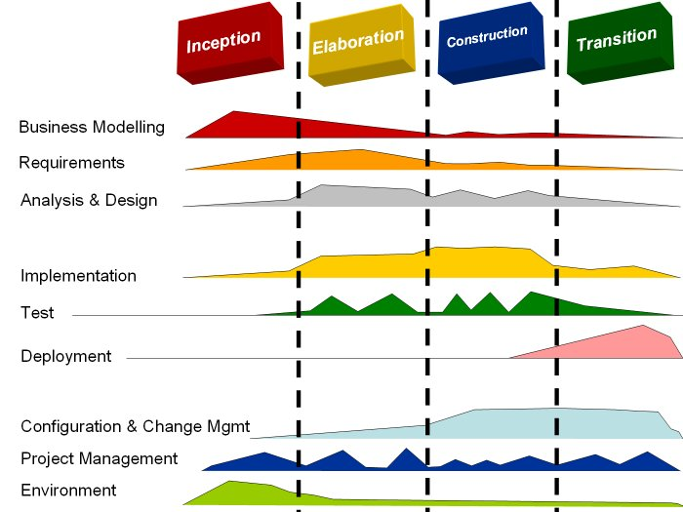
Process Model
Toll Fee Management
Rational Unified Process

Slide 12
Process Model
Toll Fee Management
Why is RUP model?
  Develop iteratively to mitigate risk early in the project
  Effectively manage requirements
  Model visually to manage complexity
  Use component architectures to build resilient architecture
  Verify quality throughout the lifecycle
  Control changes to software

Slide 13





Organizational Structure
Toll Fee Management
Mr. Huỳnh Anh Dũng
Mr. Nguyễn Văn Sang
Mr. Nguyễn Tất Trung
Instructor
Supervisor
Instructor
Nguyễn Anh
Nhật Linh
Tô Văn Quân
Nguyễn Duy Vũ
Nguyễn Xuân Hiếu
Trần Hải Đăng
- Developer
Tester
Designer
Tester
QA
Developer
Developer
Designer
Technical Leader
- Developer
Designer
Tester
- PM
- Developer

Slide 14
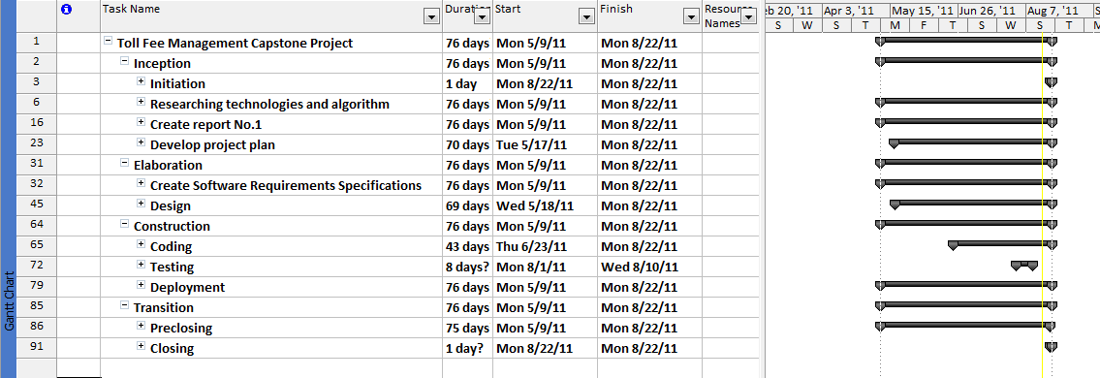
Master Schedule
Toll Fee Management

Slide 15
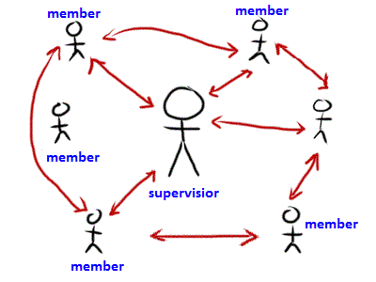
Communication
Toll Fee Management
Communication channel: Phone, Y!M, Skype, Mail, Google Group
Work together on 2nd floor at FU.
Meeting minutes with supervisor weekly 5.30pm on Friday

Slide 16
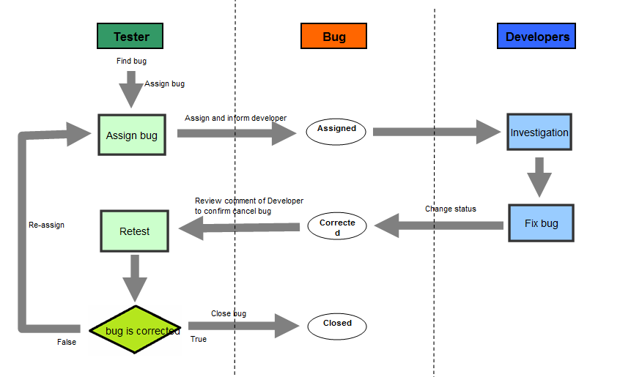
Quality Management
Toll Fee Management

Slide 17
Part 3 : Architectures &
Technology
Toll Fee Management
Develop Environment
Pattern Design
Algorithm
Architecture Design
Component Design

Slide 18








Develop Environment
Toll Fee Management

Slide 19
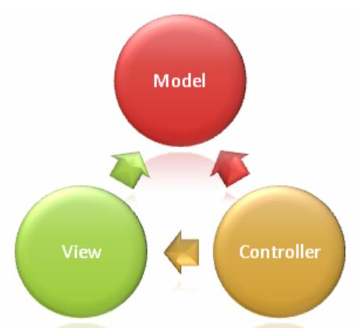
Pattern Design
Toll Fee Management
MVC
  more easily prototype your work.
  more easily migrate legacy programs
  maintain an environment that comprises different technologies across different locations.

Slide 20
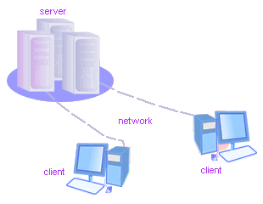
Pattern Design
Toll Fee Management
Client - Sever
  Cost savings
  Scalability
  Manage workflow
  Provide multi-tier service
  Instrumentality

Slide 21
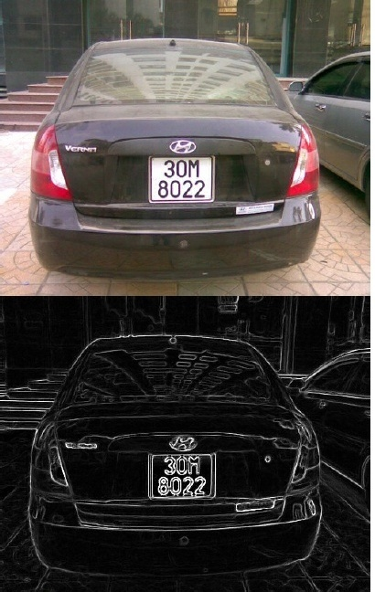
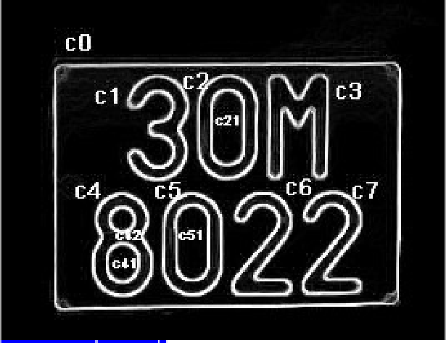
Algorithm
Toll Fee Management
Canny Algorithm
  Tree Traversal
  Tessnet2 use engine Tesseract

Slide 22
Architecture Design
Overall Design
Toll Fee Management
Clients
Browser
PNRS app
Update data
Get data
Web service
Server
Vietnam Register System database
TCMW
DSS
Database

Slide 23
Component Design Application
Toll Fee Management

Slide 24
Component Design - Website
Toll Fee Management

Slide 25
Project Result
Toll Fee Management
Product Result
Project Result
Lesson Learn

Slide 26
Product Result
Toll Fee Management
  Finish all target
  Auto number plate recognition in Application
  Website : manager ticket monthly, reports
  Crawl from Vietnam Register System’s database
  Limitation
  Charging mode manually, not automatic
  Number plate recognition is still limited

Slide 27
Product Result
Future Extension
Toll Fee Management
Technical
Payment
Deployment
Continue develop
number plate auto
recognition better
Migrate with
online payment
system
The actual
deployment

Slide 28


Project Result
Toll Fee Management
  Line of code : 12197
  Number of test cases : 393
  Number of passed case : 388
  Number of bug : 152
  Deliverable 6 report.
  Unit test
  Integration test
  System test
  Performance test

Slide 29
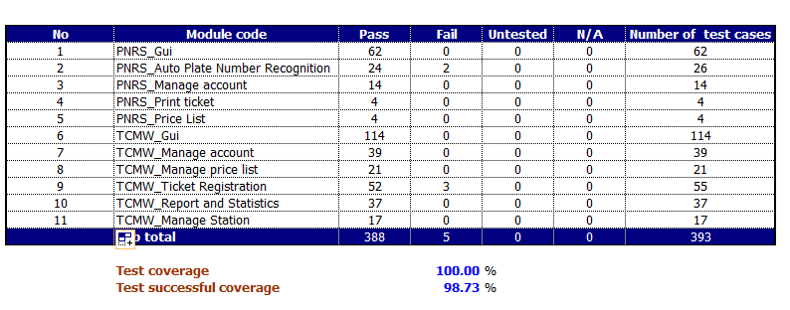
Test Report
Toll Fee Management

Slide 30
Lesson Learn
Toll Fee Management
Real
Business
Technical
Skill
Soft skill
Experience
Software
process

Slide 31
Demonstration
Demo Application
Demo Website

Slide 32
Thank You !
www.themegallery.com

