Slide 1
The War
Capstone Project
Supervisor : Trần Vinh Thu
Vũ Thành Nam 00441
Vũ Thanh Phong 00070
Lê Thành Long 00502
Đặng Đức Thắng 00150

Slide 2
Contents
1
Introduction
2
Project Management Plan
3
Software Requirement Specification
4
5
6
Software Design Description
Implementation
Test Document

Slide 3
Introduction
Background
Literature Review
Our Proposal

Slide 4
Introduction
Background
Develop a new strategy game on Android mobile
Background
Literature Review
Our Proposal

Slide 5
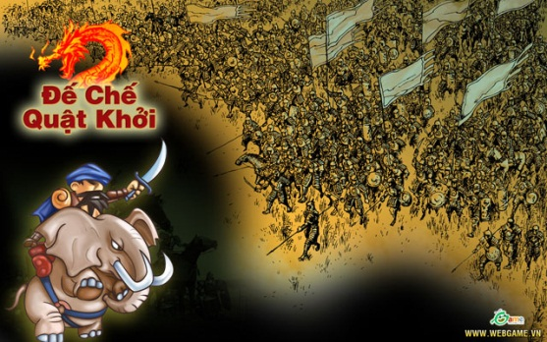
Introduction
Literature Review
Similar Systems
Background
Literature Review
Our Proposal

Slide 6
Introduction
Literature Review
Current, the age of gamers is increasing, not everyone has enough time to play a MMORPG game.
With the development of web game and the popularity of Android mobile, we decide to develop a Android game. This game directed to the officer, who hasn’t enough time to play MMORPG game. This game will help them avail little free time to relax
Background
Literature Review
Our Proposal

Slide 7
Introduction
Our Proposal
Resource exploitation: Gamer use people of castle to exploit resource. Resource use to upgrade building and manufacture equipment.
Building castles: develop your empire by upgrade the buildings of castle
Background
Literature Review
Our Proposal

Slide 8
Introduction
Our Proposal
Develop military: develop military by equip the equipment
Attack other castles: use the divisions to attack or conquer other castles
If we have enough time, we will take the game more tactical, such as general system., new equipment and new map
Background
Literature Review
Our Proposal

Slide 9
Software Management Plan
Project Organization
Software Development Model
Project Goal
Project Plan
Risk Management

Slide 10
Software Management Plan
Project Organization
Project Organization
Software Development Model
Project Goal
Project Plan
Risk Management
Project Manager
Vũ Thành Nam
Technical Leader
Lê Thành Long
Test Leader
Đặng Đức Thắng
Quality Assurance
Vũ Thanh Phong
Developer
Vũ Thành Nam
Developer
Vũ Thanh Phong
Tester
Vũ Thanh Phong
Developer
Đặng Đức Thắng
Tester
Vũ Thành Nam
Tester
Lê Thành Long

Slide 11
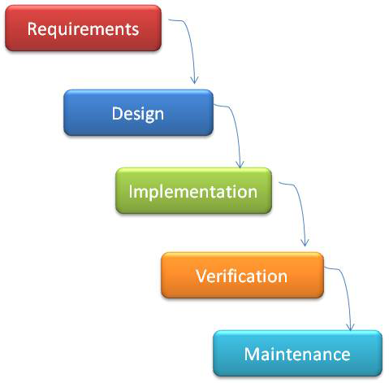
Software Management Plan
Software Development Model
Project Organization
Software Development Model
Project Goal
Project Plan
Risk Management
Use waterfall model

Slide 12
Software Management Plan
Project Goal
Project Organization
Software Development Model
Project Goal
Project Plan
Risk Management
FINISH
Studying new Technology
Working in group skills
Completed Capstone Project
Build an online community
Make money (maybe in future)

Slide 13
Software Management Plan
Project Plan
Project Organization
Software Development Model
Project Goal
Project Plan
Risk Management
Task Name | Duration | Start | Finish
Study Android OS + Network Programming | 11 days | Tue 5/8/12 | Sun 5/20/12 | 100%
Create Software Requirements Specification | 10 days | Mon 5/21/12 | Wed 5/30/12 | 100%
Software Design | 13 days | Thu 5/31/12 | Tue 6/12/12 | 100%
Development + Unit Test | 44 days | Wed 6/13/12 | Thu 7/26/12 | 100%
- Server Development | 34 days | Wed 6/13/12 | Mon 7/16/12 | 100%
- Client Apps Android | 34 days | Wed 6/13/12 | Mon 7/16/12 | 100%
- Admin Apps Java | 10 days | Tue 7/17/12 | Thu 7/26/12 | 100%
System Test | 10 days | Fri 7/27/12 | Sun 8/5/12 | 100%
Deployment | 4 days | Mon 8/6/12 | Thu 8/9/12 | 100%
Create Software User’s Manual | 6 days | Fri 8/10/12 | Wed 8/15/12 | 100%

Slide 14
Software Management Plan
Rick Management
Project Organization
Software Development Model
Project Goal
Project Plan
Risk Management
Human Resource
Discipline of team member
Lack of team work
Time and Communication
Not enough time to finish all function
Hard to connect team member due to the difference place
Technical
In-experience in Android project
Lack of equipment
Some of member often fell ill

Slide 15
Software Requirement Specification
Front-end UI
Back-end
Client’s interface for user play game
Management system for Administrator
Algorithm
Dijkstra: shortest path algorithm

Slide 16
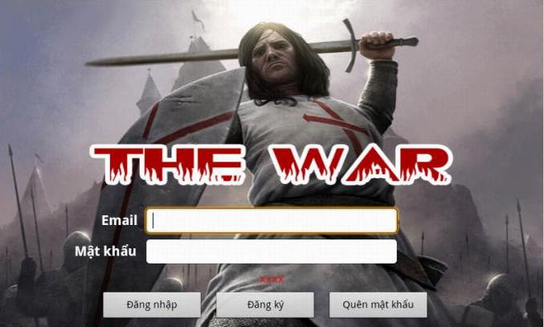
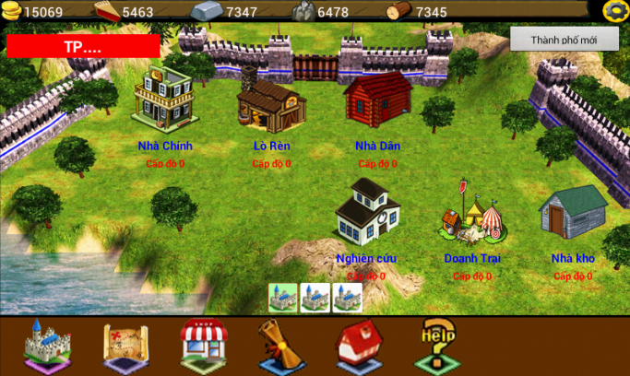
Software Requirement Specification
User
User
Register
Login
Attract other player
Create City
Upgrade Building
Upgrade Equipment

Slide 17
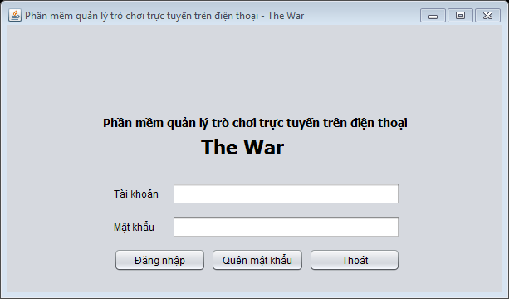
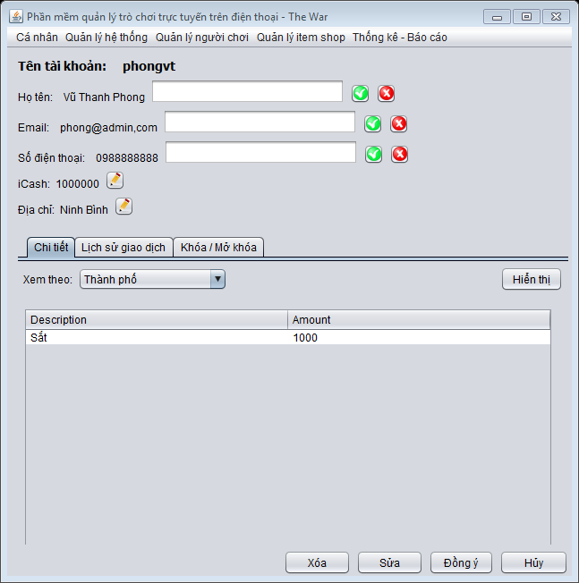
Software Requirement Specification
Administrator
Administrator
Login
Manager Users
Manager Items
Manager Events

Slide 18
Software Requirement Specification
Nonfunctional Requirement
Availability
Available : 24/7
Compatibility
Integrate with many kinds of smart phone has Android OS 2.3 or higher
Performance
Load server and connect time
Maintainability
Data recovery and system trace backs
Security
User credentials and registry

Slide 19
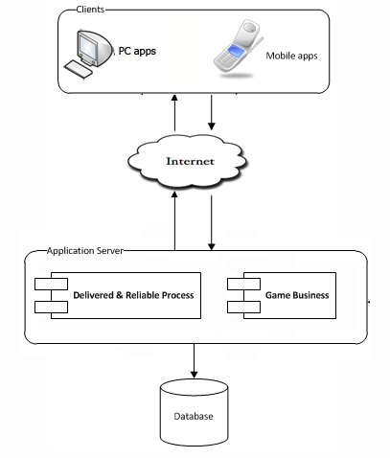
Software Design Description
Architecture – Overall Design

Slide 20
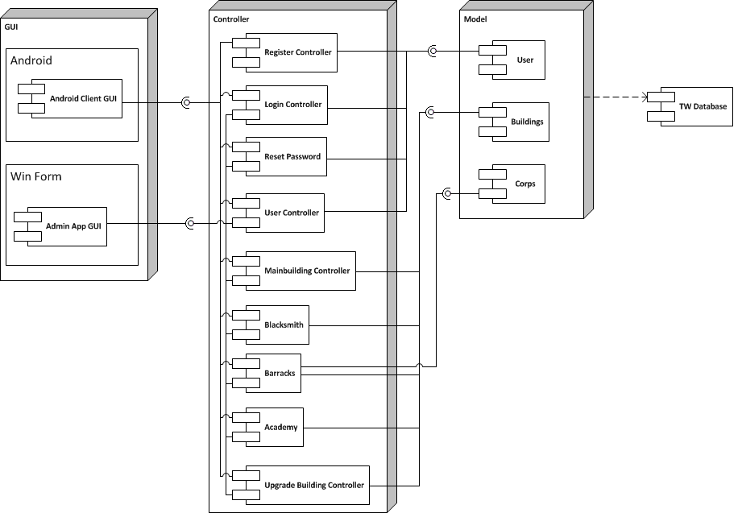
Software Design Description
Architecture – Components

Slide 21
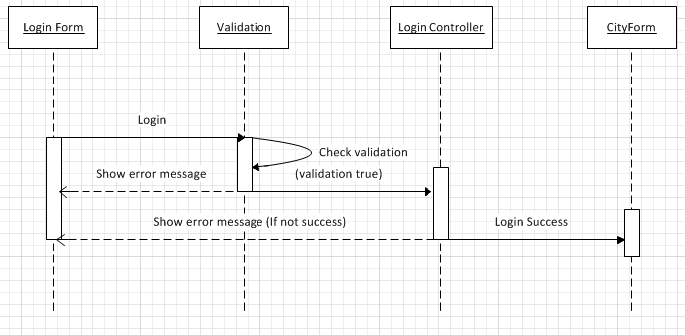
Software Design Description
Sequence Diagram

Slide 22
Software Design Description
Database Design
Database Design
- Business tables
- Every table has a primary key named Id which is of type: INT NOT NULL IDENTITY(1, 1)
- Max length and null ability strictly follow field definitions

Slide 23
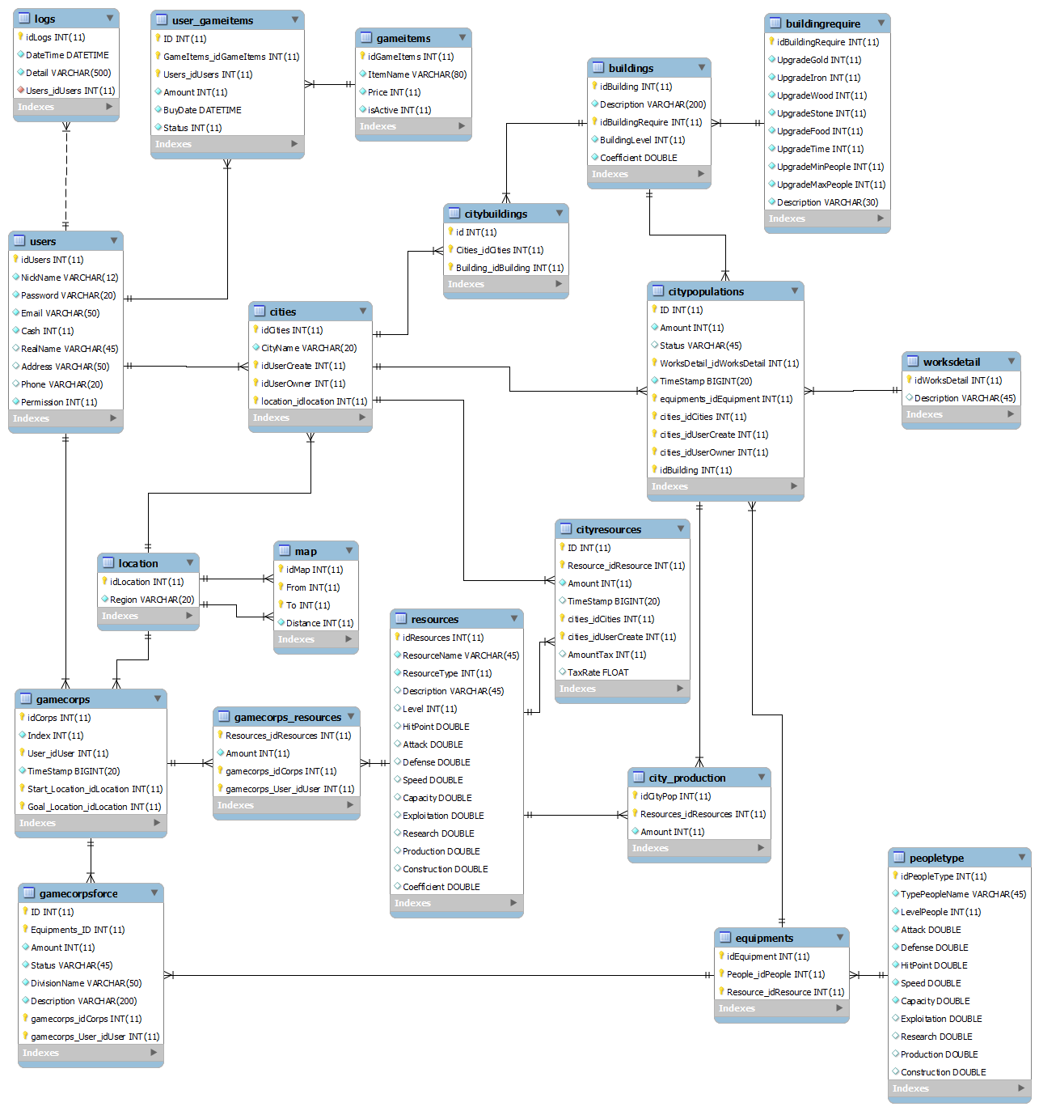
Software Design Description
Database Design - Tables

Slide 24
Implementation
Technologies

Slide 25
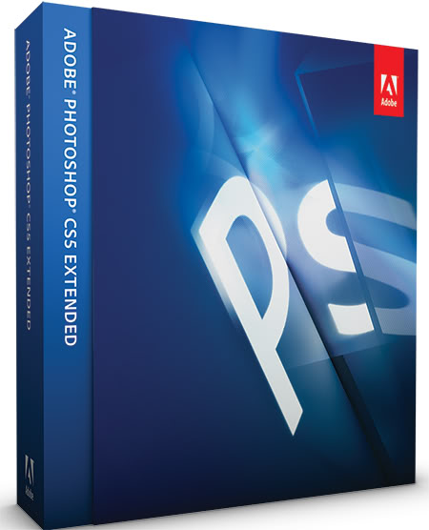
Implementation
Tools

Slide 26
Implementation
Coding Convention
Follow general Android's Java conventions
Naming Style
Comment

Slide 27
Test Documentation
Include
Include
Features to be tested
Features not to be tested
Test case
Check list
√
√
√
√

Slide 28
Test Documentation
Test Result
174
Number of test cases
174
Number of passed cases
14
Number of failed cases (fixed all)
0
Number of no tested cases

Slide 29
Test Documentation
Test Result
Unit test
Integration test
System test
Performance Test
User Acceptance Test

Slide 30
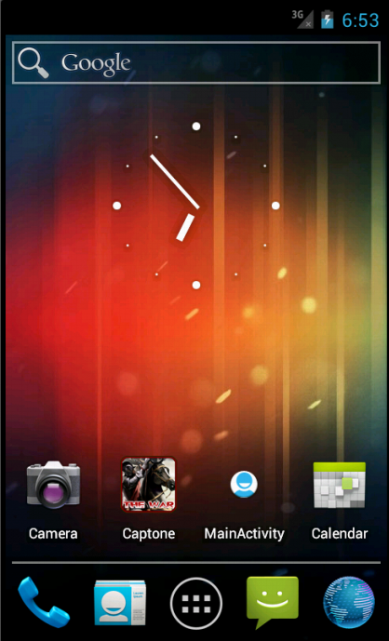
Demo
Click here to start game

Slide 31
Thanks for listening
Especially for Mr. Trần Vinh Thu

