Slide 1


FUFO Project
Final Report

Slide 2

Contents
1
Introduction
2
Hardware & Software
3
Algorithms
4
Experiments & Results
5
Conclusion

Slide 3
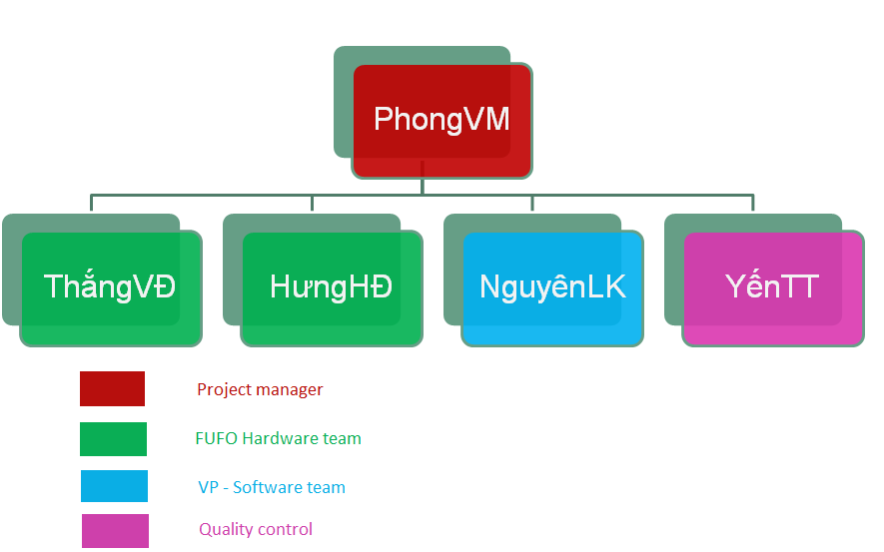
FUFO team
Introduction

Slide 4
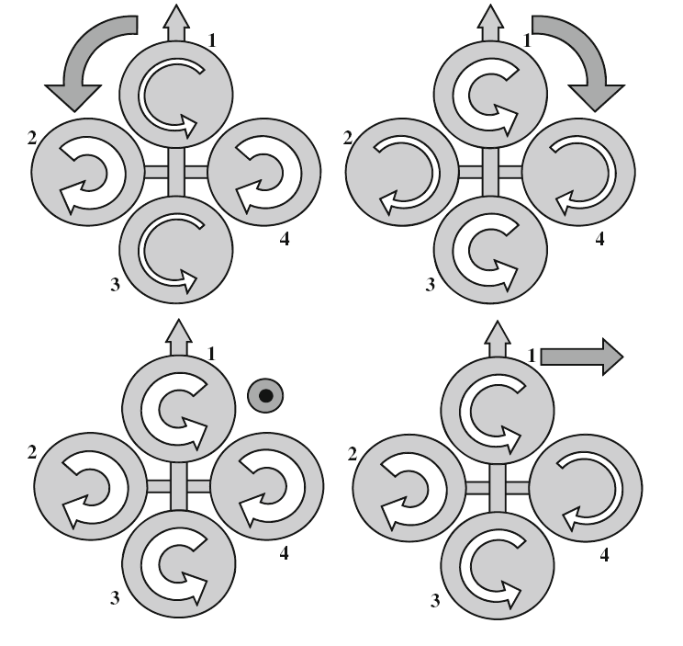
History
Introduction
Definition:
  A Vertical Take-Off and Landing aircraft.
  Has 4 rotors.

Slide 5
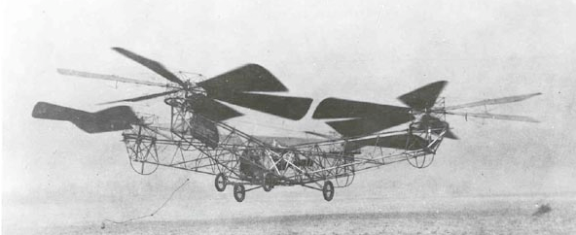
History
Introduction
The first Quadrocopter was developed in 1920.
No commercialized Quadrocopter because of limitation of technology and science at that time.

Slide 6
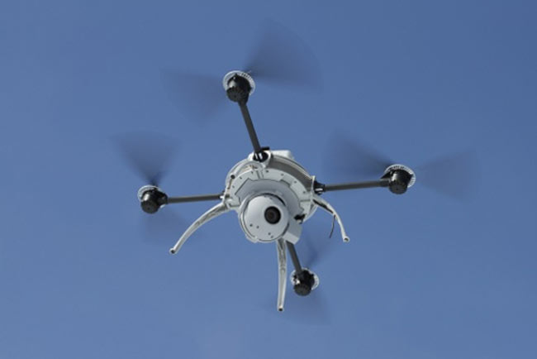
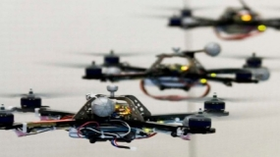
History
Introduction
8 years before 2012, many institutes and companies began to research on this platform as a small UAV.

Slide 7
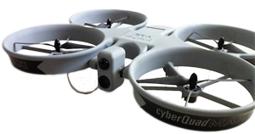
Commercialized product
Introduction
Airbot X600-BKPP (€ 34,500)
  Radio control unit (2.4 GHz)
  Live video stream
  GPS waypoint navigation
CyberQuad Maxi ($ 36,000)
  Radio control unit
  GPS waypoint navigation
  Live video stream

Slide 8
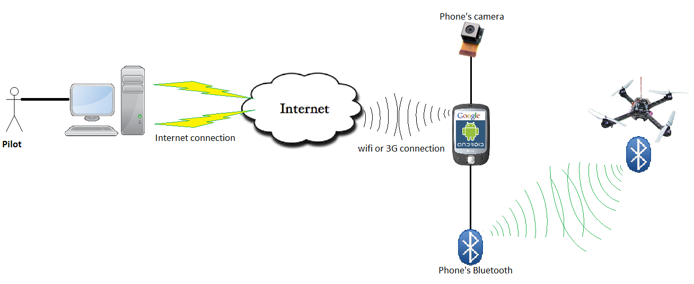
Idea
Introduction
  Develop a Quadrocopter for observation purpose.

Slide 9
Idea
Introduction
Why choosing Quadrocopter platform?
 | Quadrocopter | Helicopter | Fixed-Wing aircraft
Aerodynamics mechanical design | No | Yes | Yes
Control method | Medium | Medium | Complicated
Runway | No | No | Yes
➔ Quadrocopter is more suitable for embedded Engineering students who are not familiar with aerospace issue and mechanical design.

Slide 10
Idea
Introduction
Why choosing Android Phone?
 | Android phone | In-circuit designs
Software development | Android SDK | Linux, C30…
Evaluation of controlling by phone/tablet via Bluetooth? | Yes | No
Risk and complexity in hardware design | Low | High
Cost | Low | High
Has built-in camera, Wi-Fi, 3G module
Phone is still usable after this Capstone project

Slide 11
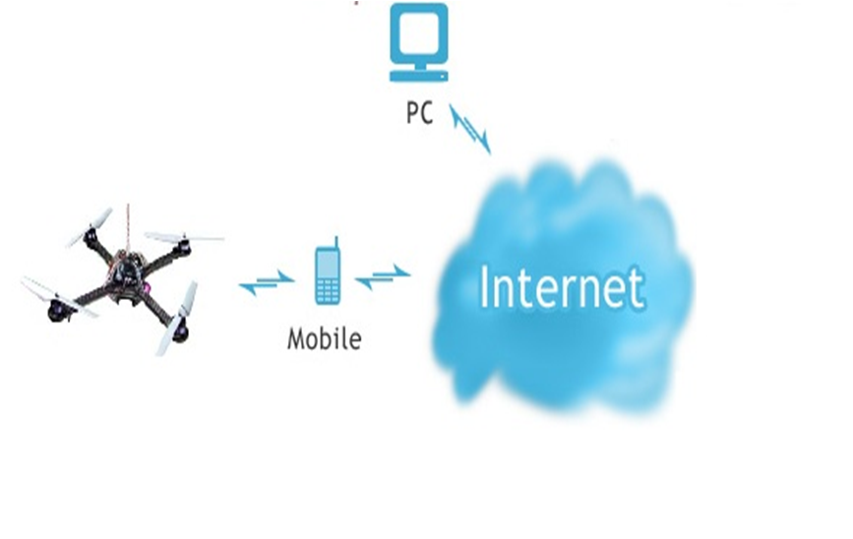
Idea
Introduction
Command
Sensor data
Bluetooth

Slide 12
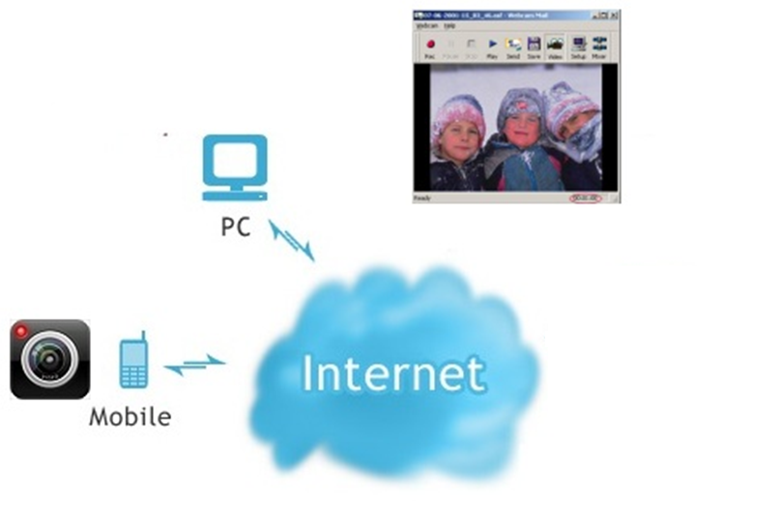
Idea
Introduction
Picture
Picture
JPEG
JPEG

Slide 13
Idea
Introduction
Control Mode
Autonomous(Dynamic Stabilization)
Manual

Slide 14
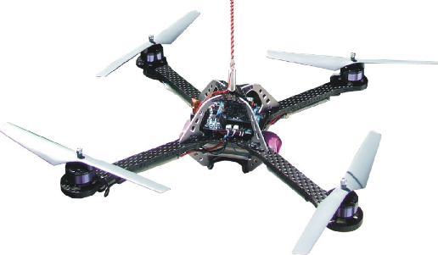
Idea
Introduction
Wind
Manual mode

Slide 15
Idea
Introduction
Dynamic stabilization
Wind
Dynamic Stablization
SAFE
Go to 1m

Slide 16
Hardware study
Hard & Soft
No. | Components | Quantity | Description
1 | dsPIC30f4012 | 1 | Microcontroller
2 | HC-06 | 1 | Bluetooth module
3 | BMP085 | 1 | Barometer
4 | L3G4200D | 1 | Gyroscope
5 | ADXL345 | 1 | Accelerometer
6 | HW 30A ESC | 4 | Electronic speed Controller
7 | Himodel 2212 1400kv | 4 | Brushless motor
8 | Turnigy 3000mAh 11.1v 3s | 2 | Li-Po battery pack.
9 | HTC HD2 | 1 | Android 2.3 phone

Slide 17
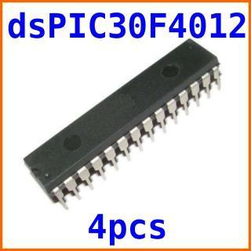
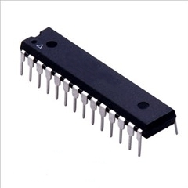
Hardware study
Hard & Soft
dsPIC30f4012 Microcontroller
  Max speed: 30 MIPS
  16x16 bit working arrays
  5 timers, 3 PWM generators
  Programmable by C30.

Slide 18
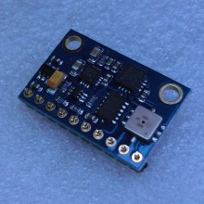
Hardware study
Hard & Soft
BMP085 + ADX345 + L3G4200D
  All-in-one module:
    3-axis accelerometer.
    3-axis gyroscope.
    -300m to 9000m altimeter.

Slide 19
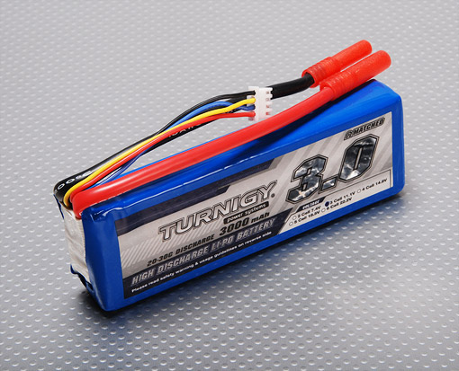
Hardware study
Hard & Soft
Turnigy 3000mAh battery pack
  3000mAh x 2
  253 grams x 2
  11.1v
  Discharge rate: 20C

Slide 20
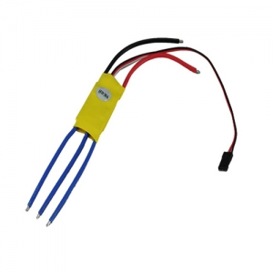
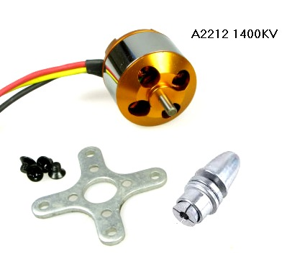
Hardware study
Hard & Soft
Motor and ESC
  1400kv Brushless motors
  8x4” propellers
  ESC PWM range: 1ms – 2ms

Slide 21

Hardware study
Hard & Soft
HTC HD2 Android 2.3
  320x240 camera.
  Has Bluetooth and Wi-Fi connection
  Run on Android 2.3

Slide 22
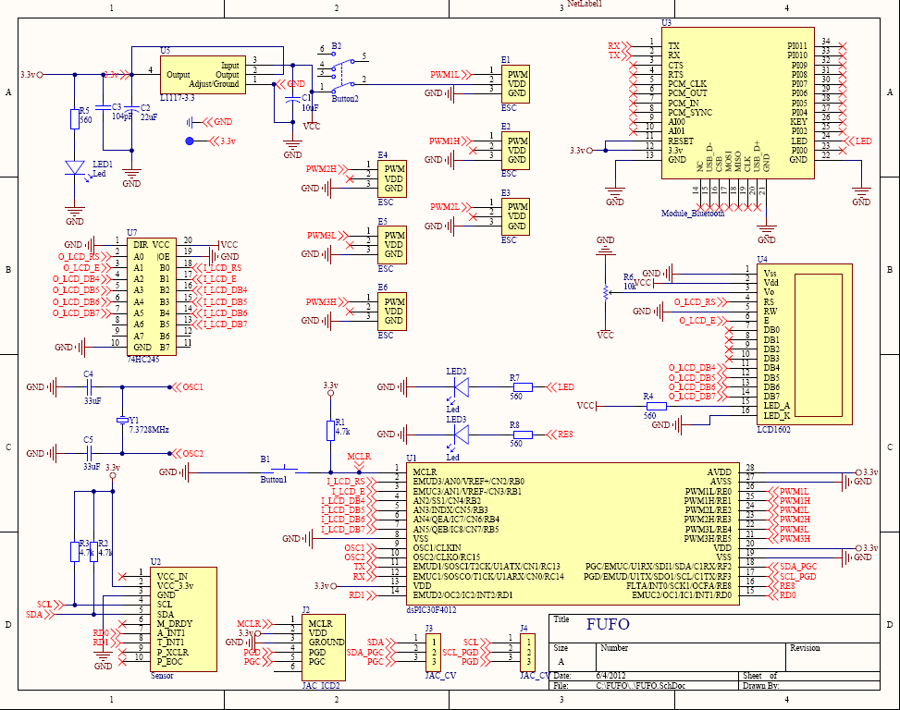
Hardware design
Hard & Soft

Slide 23
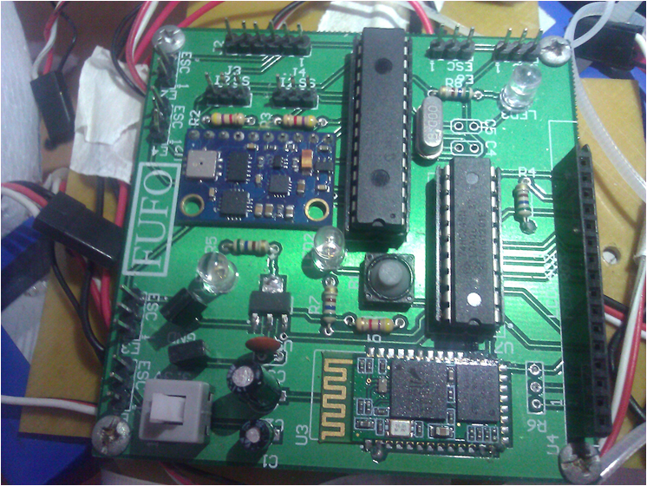
Hardware design
Hard & Soft

Slide 24
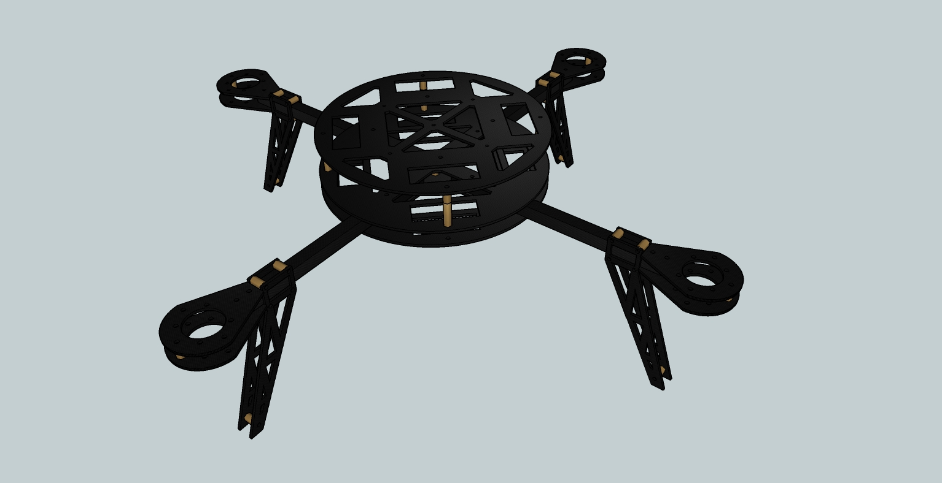
Frame design
Hard & Soft
Circuit mount
440 mm
Motor mount
Fiber Glass & Fiber Carbon

Slide 25
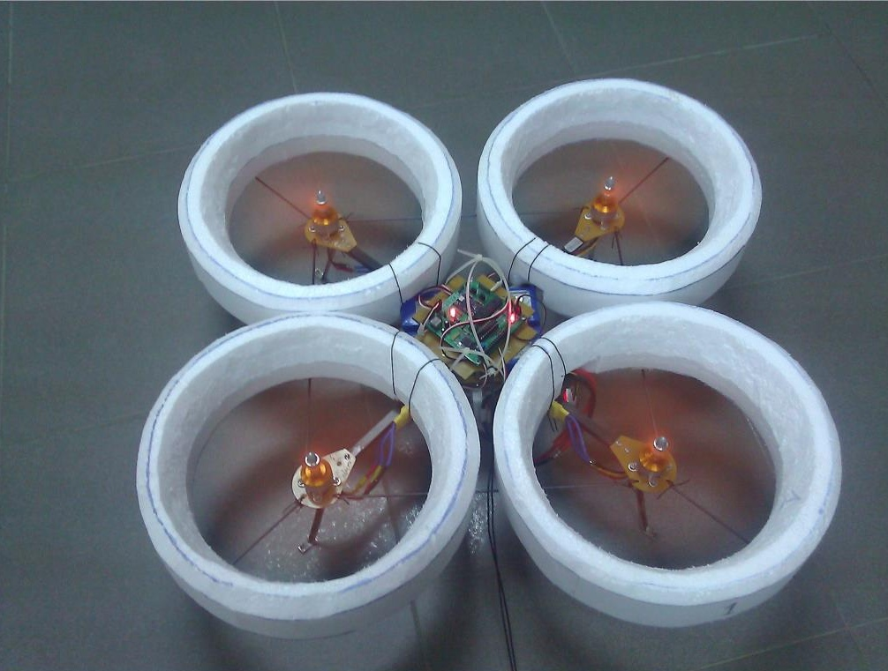
FUFO Quadrocopter
Hard & Soft

Slide 26
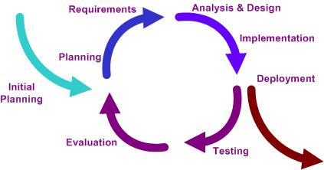
Software study
Hard & Soft
Iterative model:

Slide 27
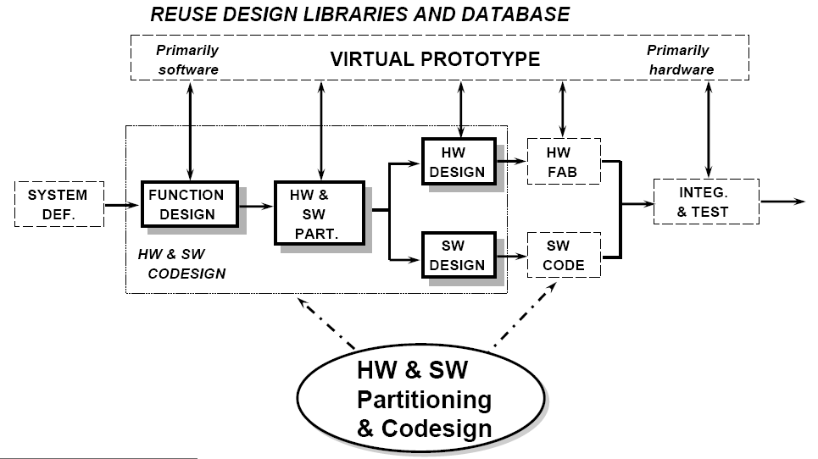
Software study
Hard & Soft
Embedded system development:

Slide 28
Software study
Hard & Soft
Three software:
  Software on PC
  Software on Phone
  Firmware

Slide 29
Software study
Hard & Soft
FSM:
System initiated
System connected
WaitingForConnection
Start
Verify
Power on
Control
method
selected
Sensor data
initiated
Start button
pressed
Ready
SetupForFlight
Pending
First altitude
is chosen
Any error
Hovering
Error
Altitude is
set to zero
Landing
Motor stopped

Slide 30
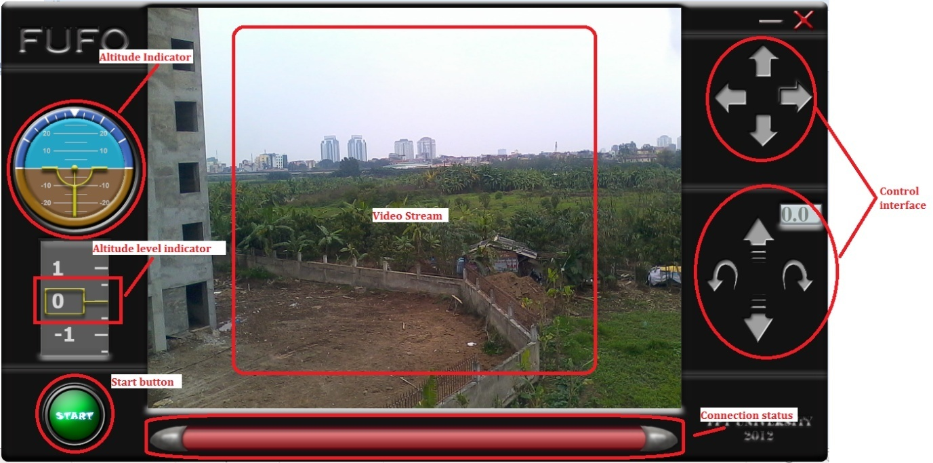
Software study
Hard & Soft
PC interface:

Slide 31
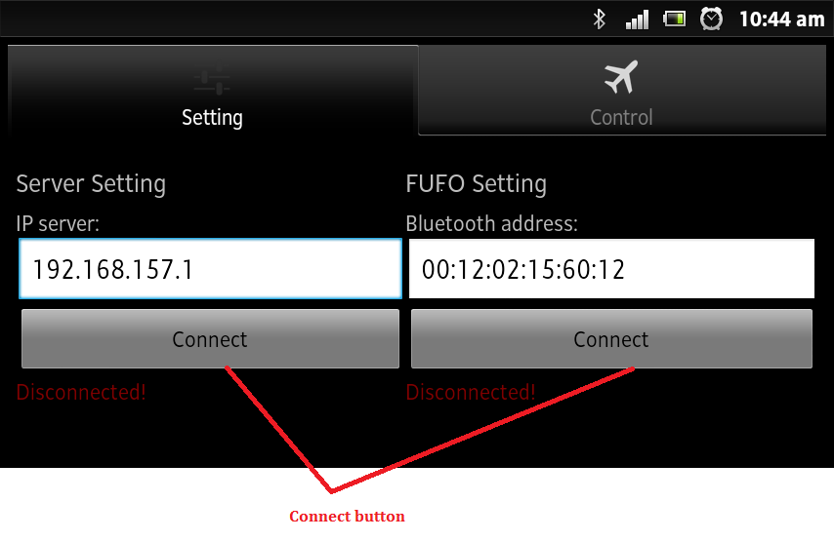
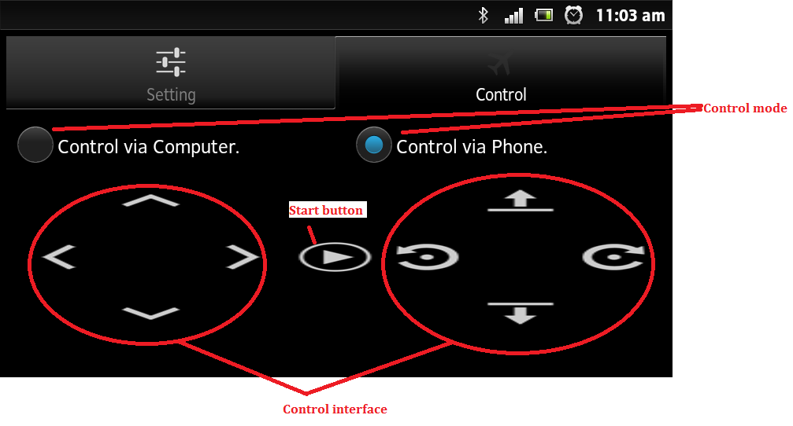
Software study
Hard & Soft
Android interface:

Slide 32
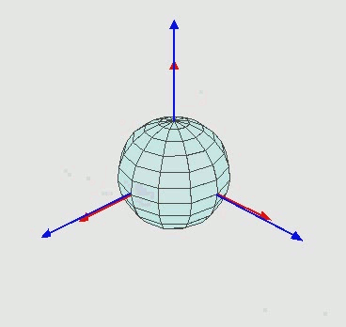
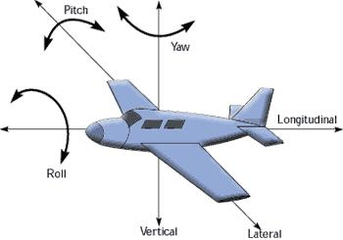
Quadrocopter Dynamic
Algorithms
Inertial Frame, Body frame and Euler Angle:

Slide 33
Quadrocopter Dynamic
Algorithms
Input:
  𝜂₁ = [x,y,z];
  𝜂₂ = [𝜃,𝜑,𝜓];
  x = y = 0.
Output:
  [F₁,F₂,F₃,F₄]
  Linear translational movement
  Rotational movement

Slide 34
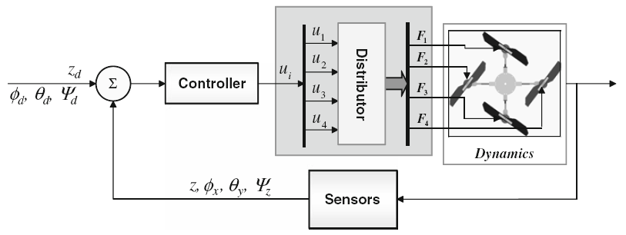
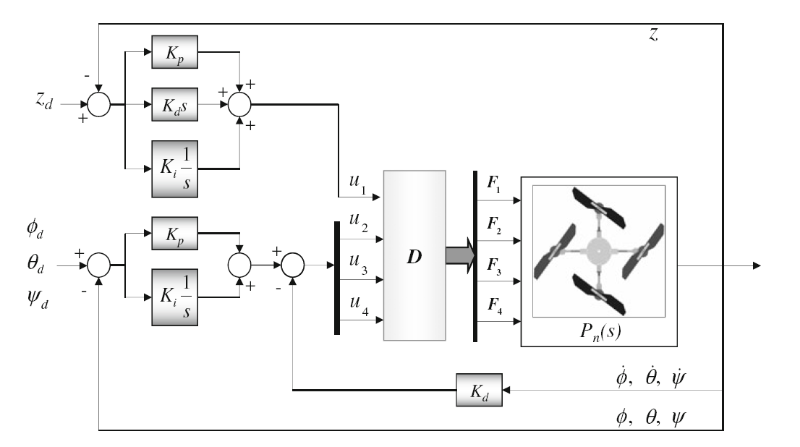

PID Control system
Algorithms
Open-loop feedback controller:

Slide 35
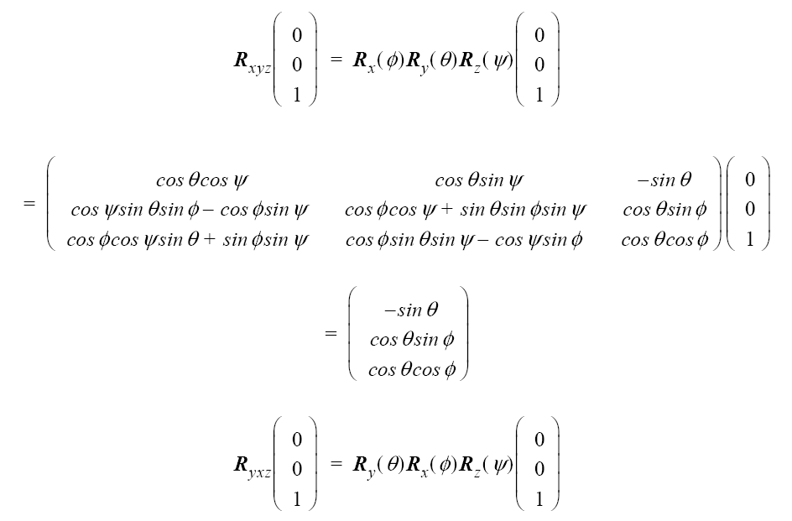
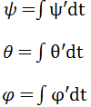

Signal Processing
Algorithms
Euler angles calculation:
  Gyroscope: Integration of angular velocity over time.
  Accelerometer: Multiplication with a (x,y,z) Direction Cosine Transformation Matrix.

Slide 36
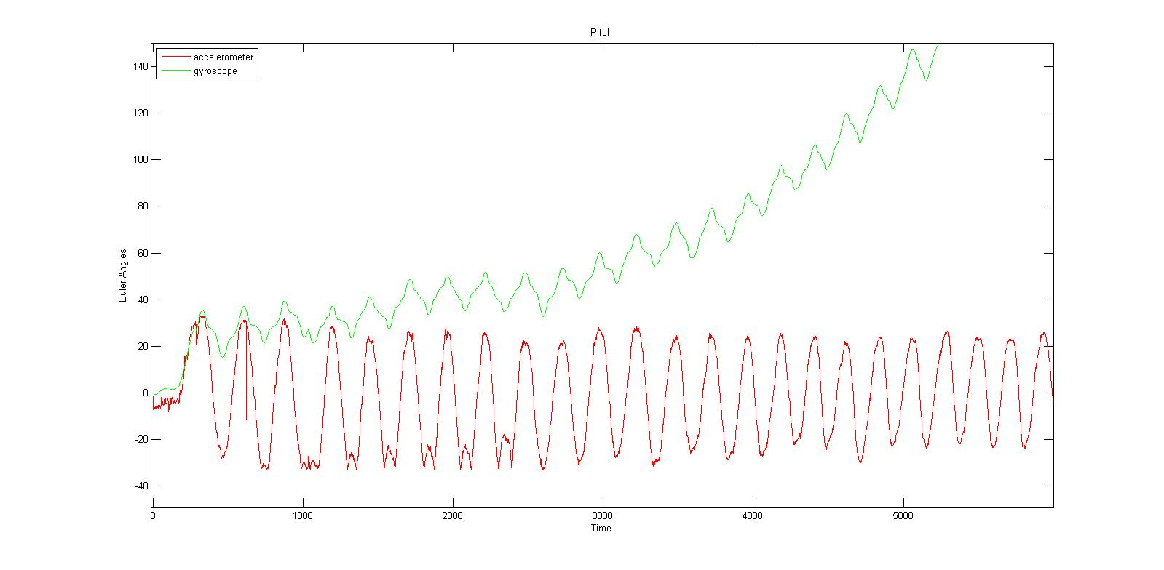
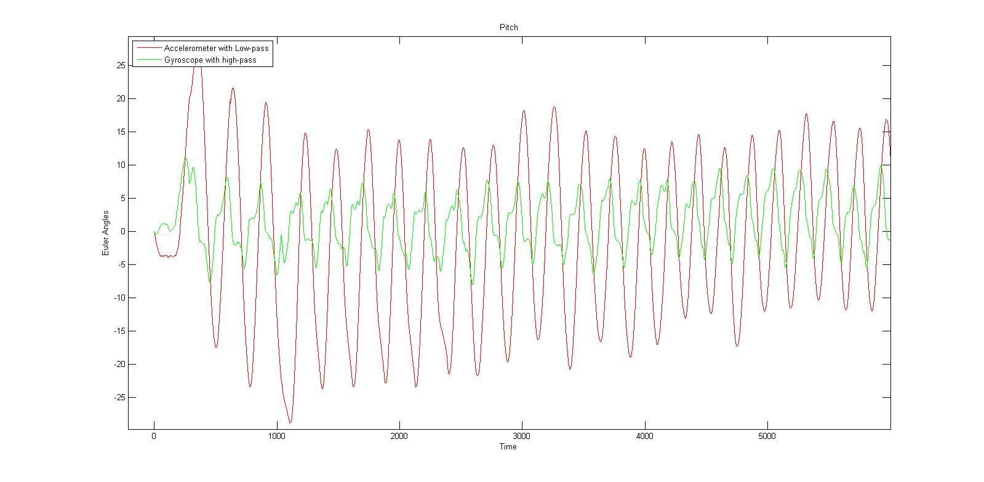
Signal Processing
Algorithms
Theta angle by Accelerometer and Gyroscope:
AFTER HIGH-PASS AND LOW-PASS FILTER
BEFORE FILTER

Slide 37
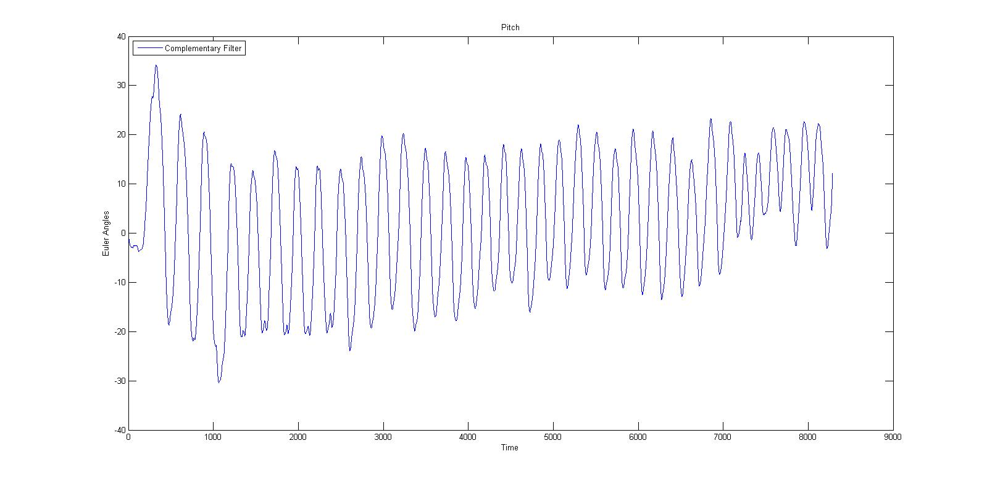
Signal Processing
Algorithms
Theta angle by Accelerometer and Gyroscope:
AFTER COMPLEMENTARY FILTER

Slide 38
Experiments
Experiment
<Show video>

Slide 39
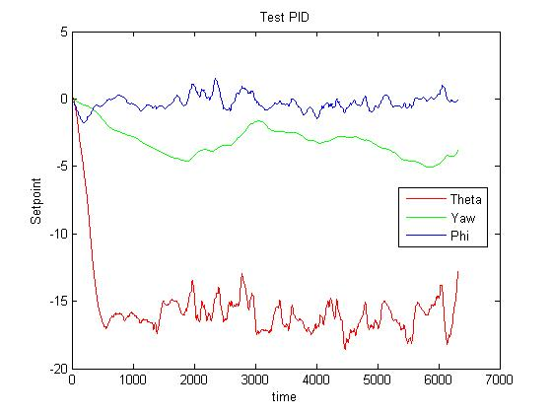
Results
Experiment
Indoor flight:

Slide 40
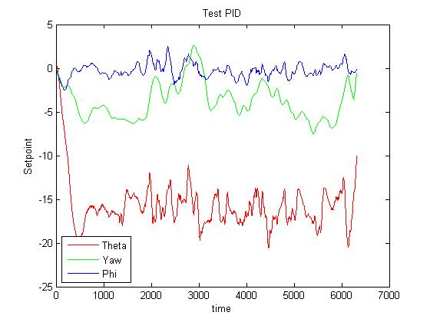
Results
Experiment
Outdoor flight:

Slide 41
Achievement
Conclusion
Successfully proved the correctness of the aforementioned algorithms.
Understand more about this flying platform for further improvement and development.

Slide 42
Future Improvement
Conclusion
Develop a higher response system.
Hold altitude in narrow and low area with precision of +-0.1 m
Hold a specified position on map or moving on a track.
Obstacle detection and avoidance.
CMOS camera's video transmission over long distance.
Object detection based on image processing.

Slide 43

www.themegallery.com
Thank You !
From FUFO team with love

